Slide 1
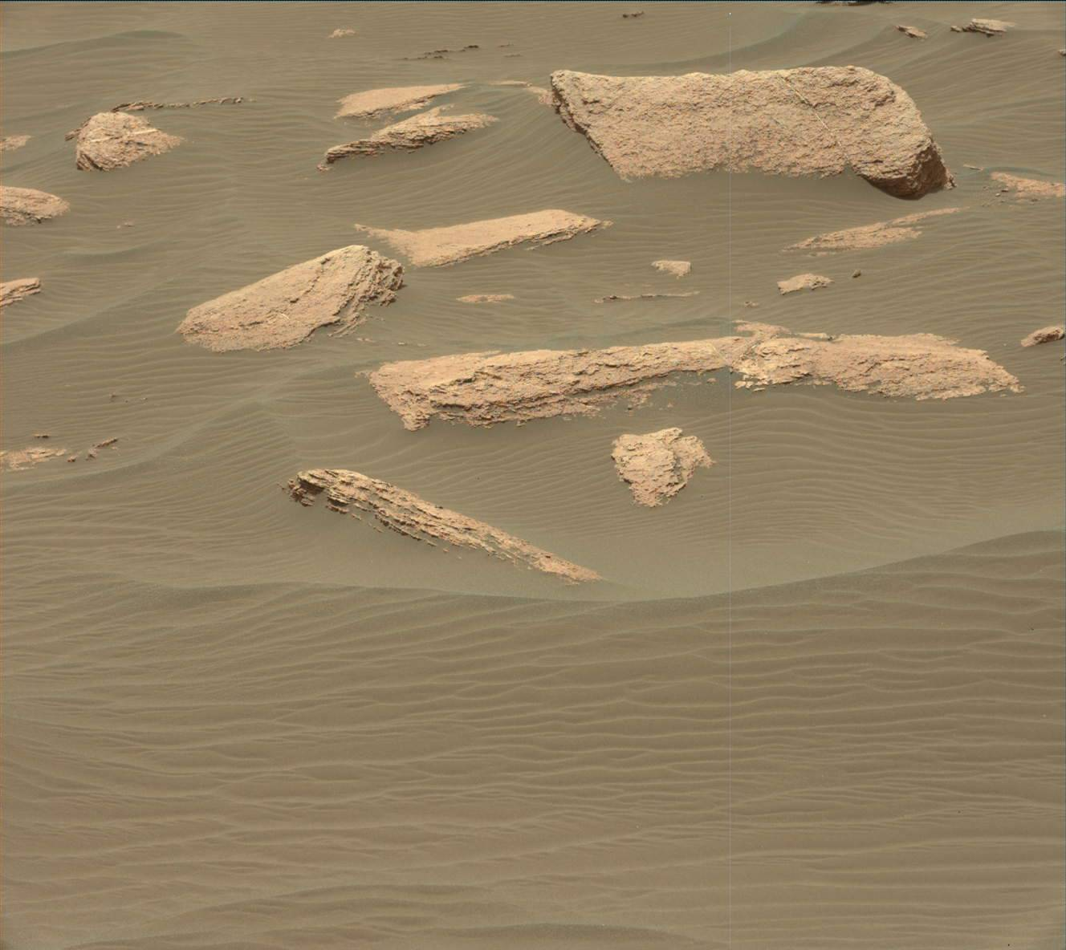
PLANETARY GEOLOGY
Lecture 4 - Mars Exploration
Sol 1635, MastCam, image credit NASA/JPL
Dott. Fulvio FRANCHI, PhD

Slide 2
Lecture 4 – Mars Exploration
TOPICS TO BE COVERED:
Missions from Viking to MSL mission
Data from Curiosity rover
Sol 1635, MastCam, image credit NASA/JPL

Slide 3
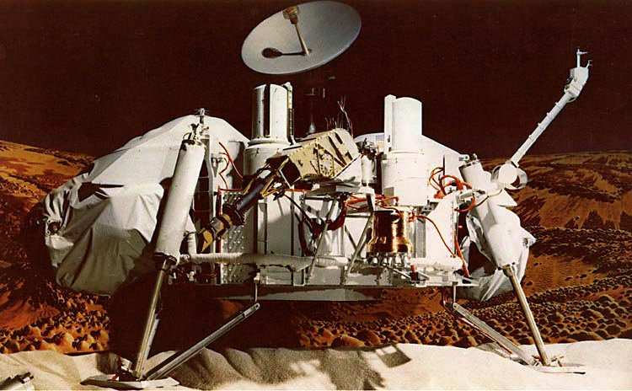
Viking - 1976
2001 → Mars Exploration Rovers [NASA]
2004 Spirit + Opportunity rovers
2004 → Mars Express [ESA]
2005 → Mars Reconnaissance Orbiter [NASA]
2012 → Mars Science Laboratory [NASA]
Curiosity Rover
Thanks to Dr Susanne Schwenzer from The Open University for this fantastic material about Mars exploration and, most of all, Curiosity Rover scientific breakthroughs.

Slide 4
Mars Exploration Rovers: Spirit and Opportunity
Spirit:
Landed 4th January 2004
Designed for 90 sols and 600 m (0.4 mi)
Drove 7.73 km (4.8 mi)
lasted 6 years 2 months 19 days, or over 25 times the original planned mission duration
Opportunity:
Landed 25th January 2004
Designed for 90 sols and 600 m (0.4 mi)
Drove 25.86 miles (41.62 kilometers)
Stopped June 2018

Slide 5
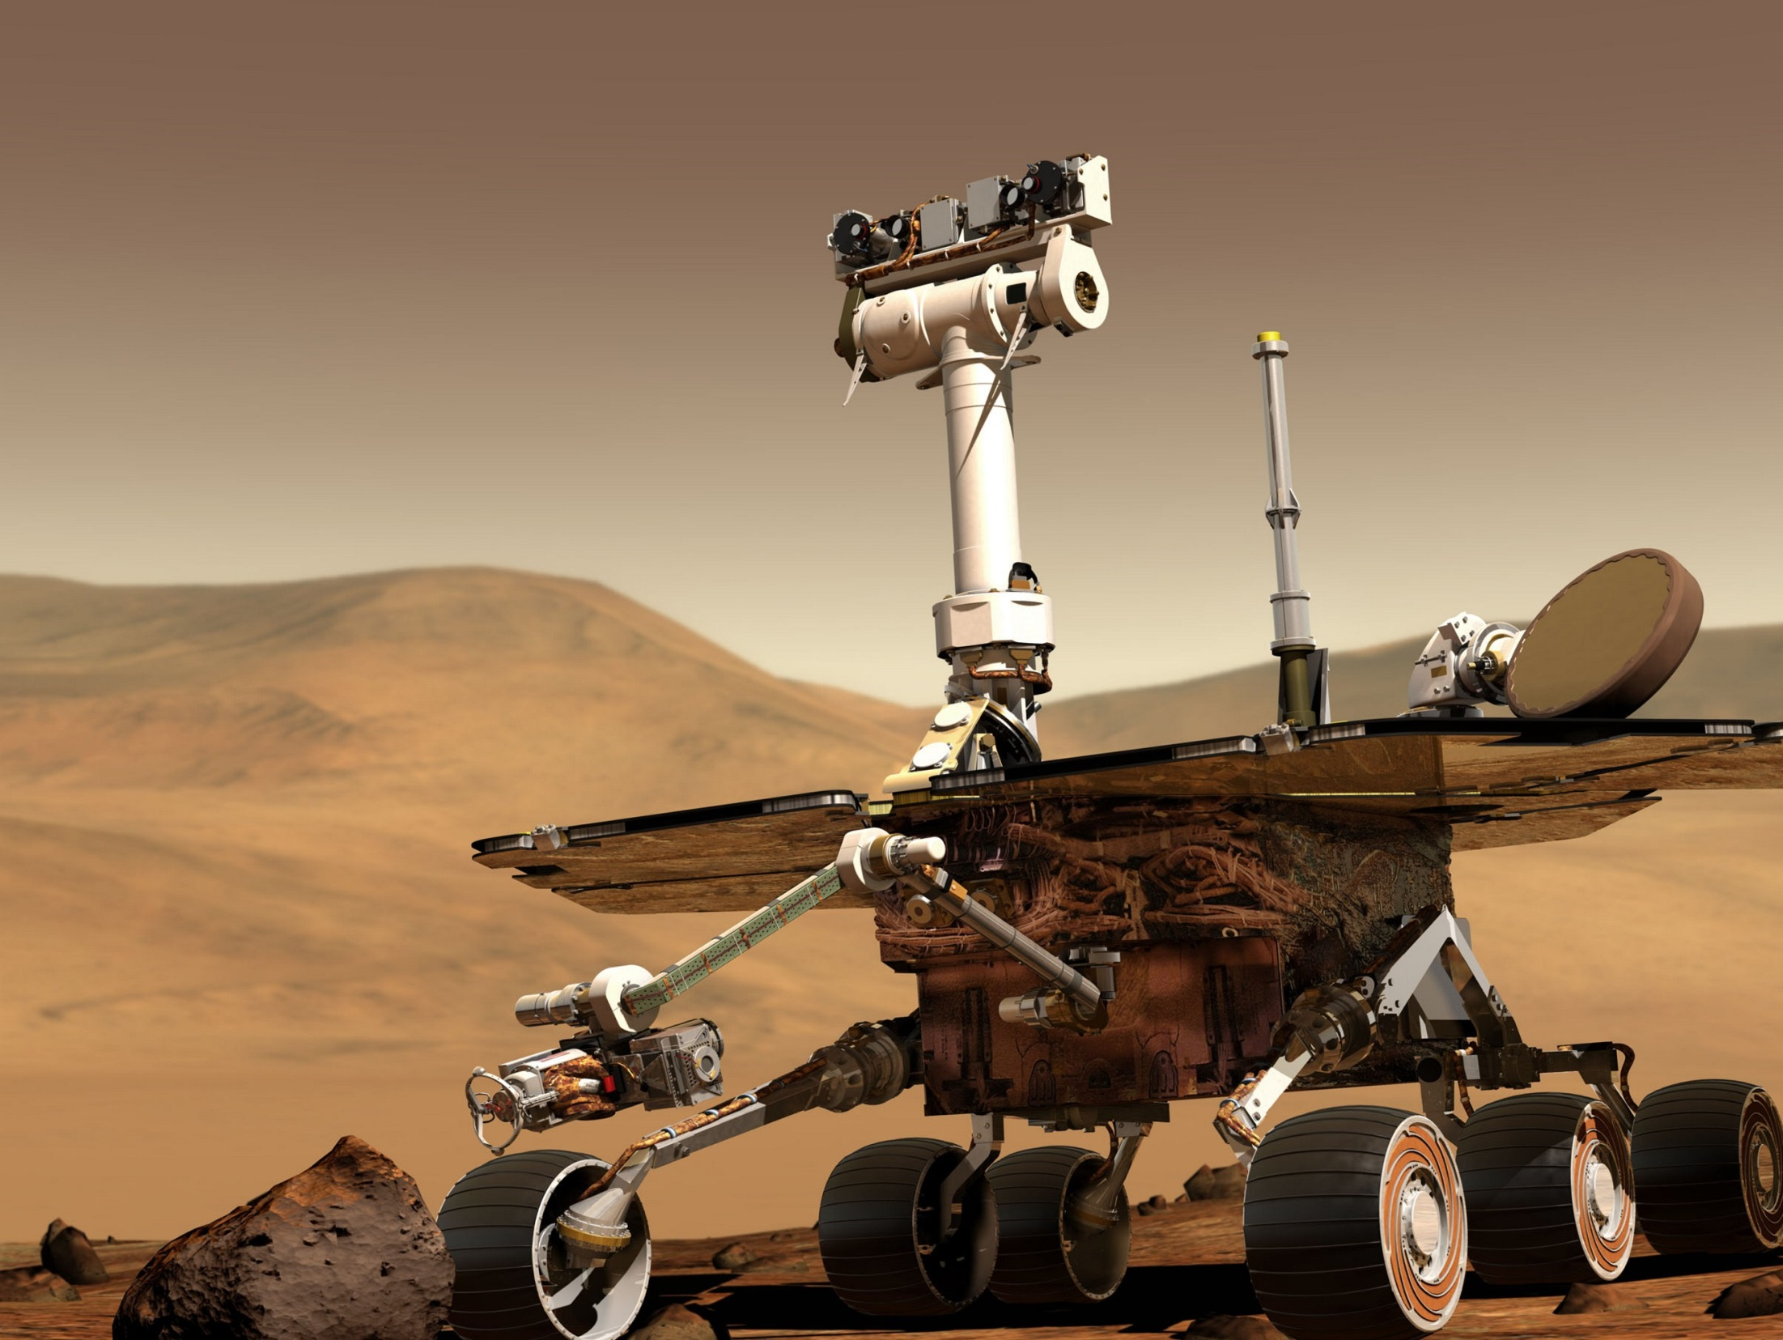
The Athena Mars Rover Science Payload
Remote Sensing Package
Pancam Mast Assembly (PMA)
Pancam
Mini-TES
In-Situ Package
Instrument Deployment Device (IDD)
Microscopic Imager
Alpha Particle X-Ray Spectrometer
Mössbauer Spectrometer
Rock Abrasion Tool
Mars Exploration Rovers 2001
Dr. Jutta Zipfel, MPI Mainz

Slide 6
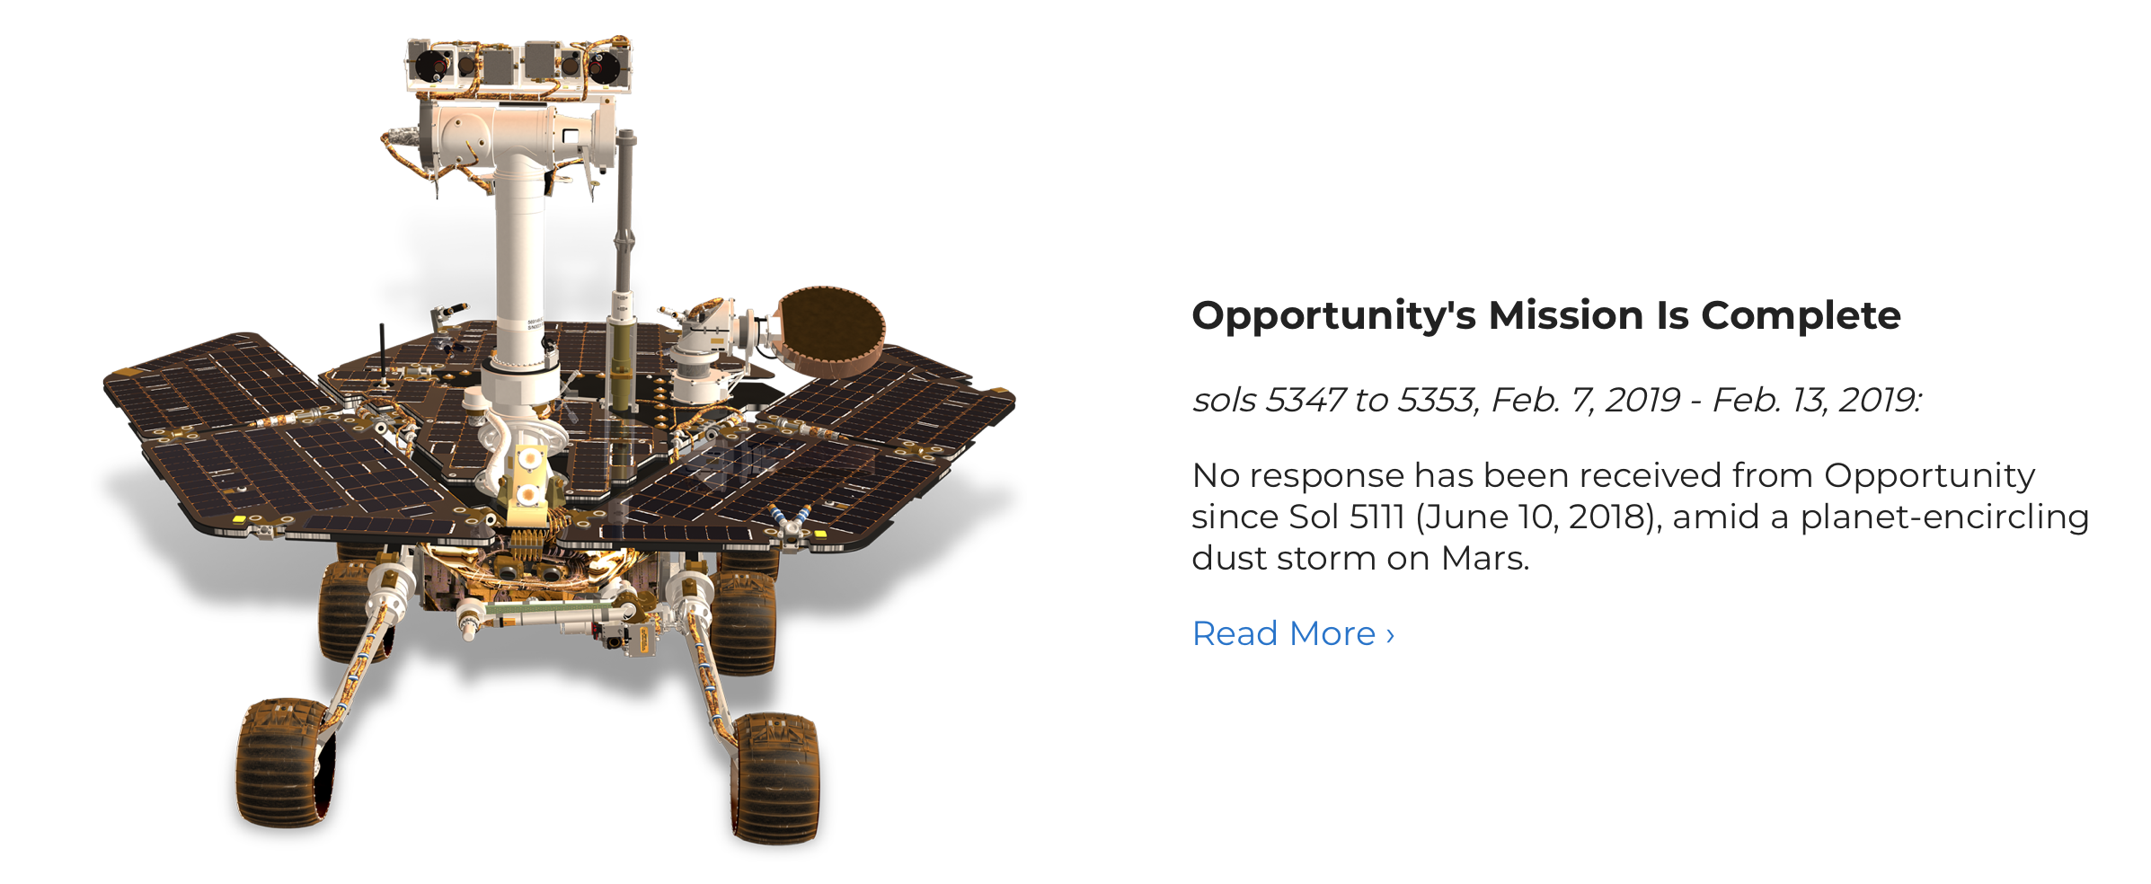
Pillinger Point, published 24 June 2014:
Mars Rover Opportunity - Mars Missions - NASA Jet Propulsion Laboratory

Slide 7
Mars Express (2004) – ESA mission
Mars Express hosts eight scientific instruments:
HRSC (High Resolution Stereo Camera)
OMEGA (Visible and Infrared Mineralogical Mapping Spectrometer)
MARSIS (Sub-surface Sounding Radar Altimeter)
PFS (Planetary Fourier Spectrometer) SPICAM (Ultraviolet and Infrared Atmospheric Spectrometer),
ASPERA (Energetic Neutral Atoms Analyser)
VMC (Visual Monitoring Camera).
Jezero Crater delta

Slide 8
Mars Reconnaissance Orbiter (2005) - NASA
High Resolution Imaging Experiment (HiRISE)
30cm/pixel resolution
Source: mars.nasa.gov/mro/

Slide 9
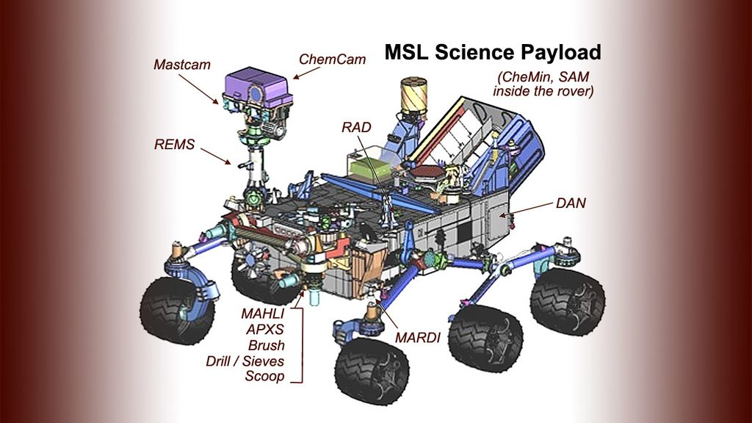
NASA Mars Science Laboratory Mission
CURIOSITY Rover (landed 2012)
Top speed: 4 cm/sec
image credit: NASA/JPL

Slide 10
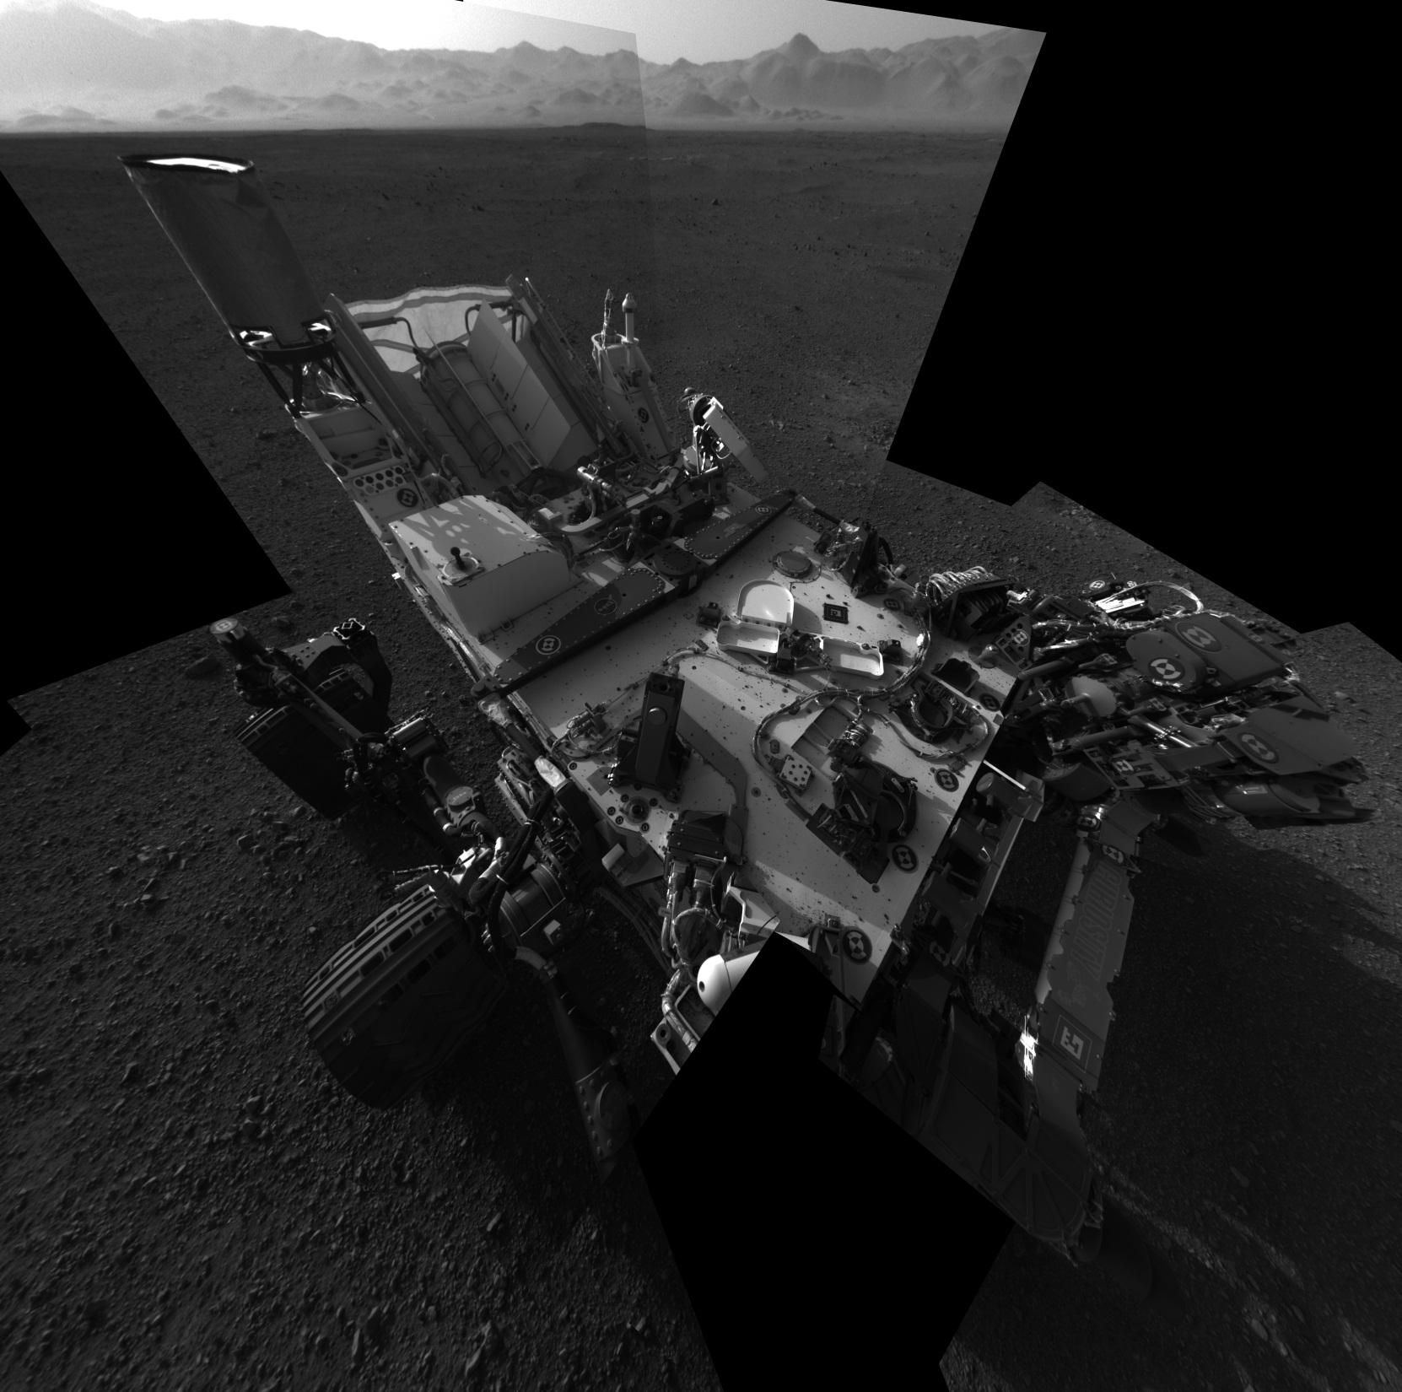
image credit: NASA/JPL

Slide 11
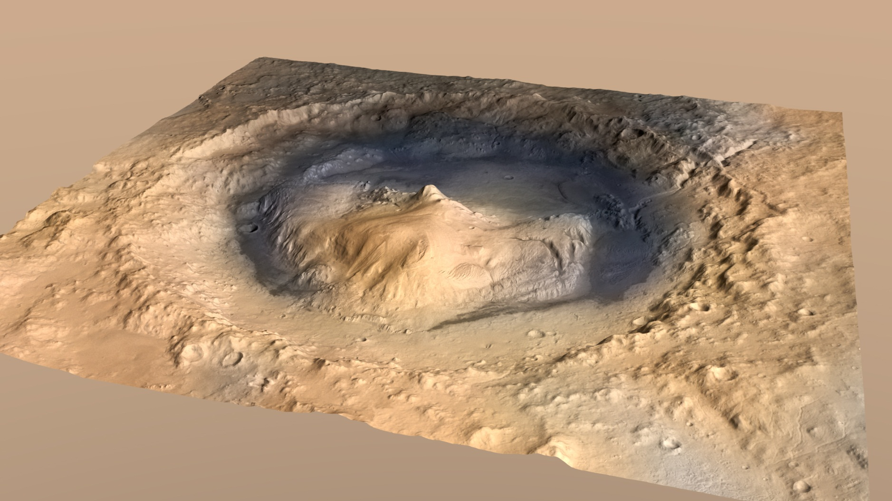
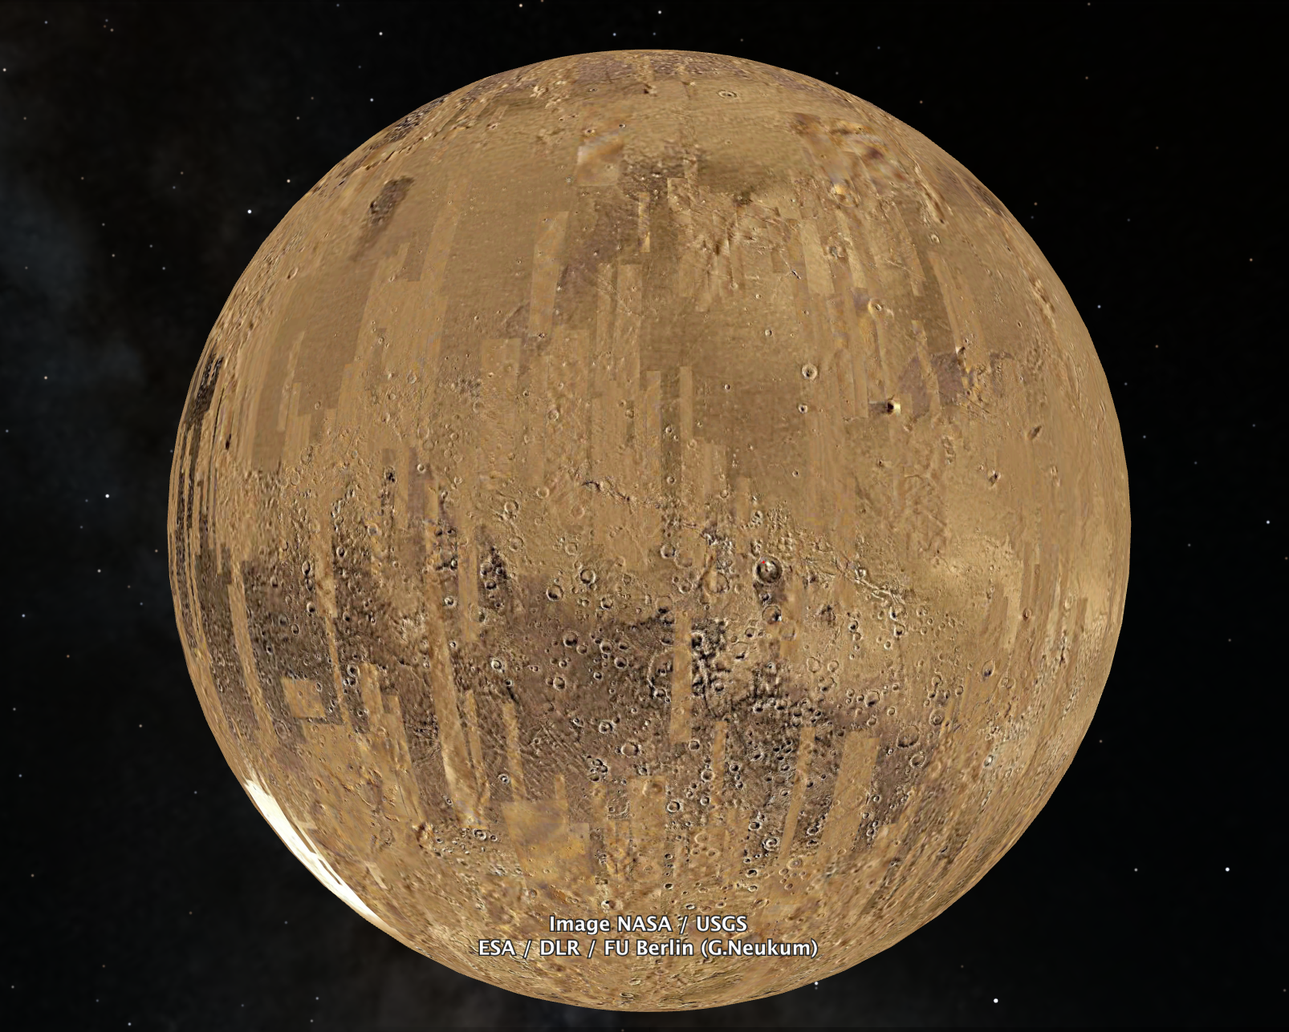
This is Gale Crater:

Slide 12
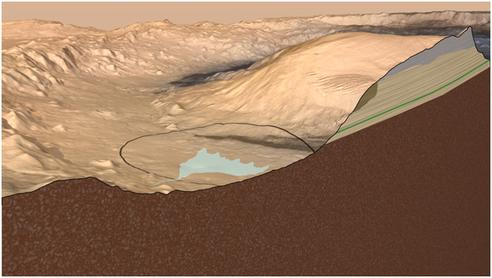
image credit: NASA/JPL

Slide 13
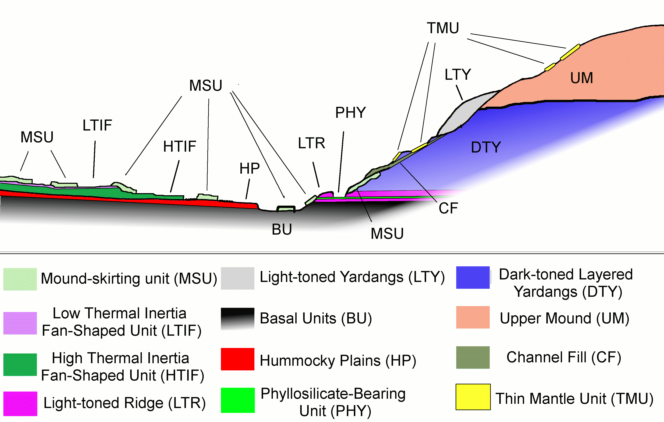
Anderson and Bell, Marsjournal

Slide 14
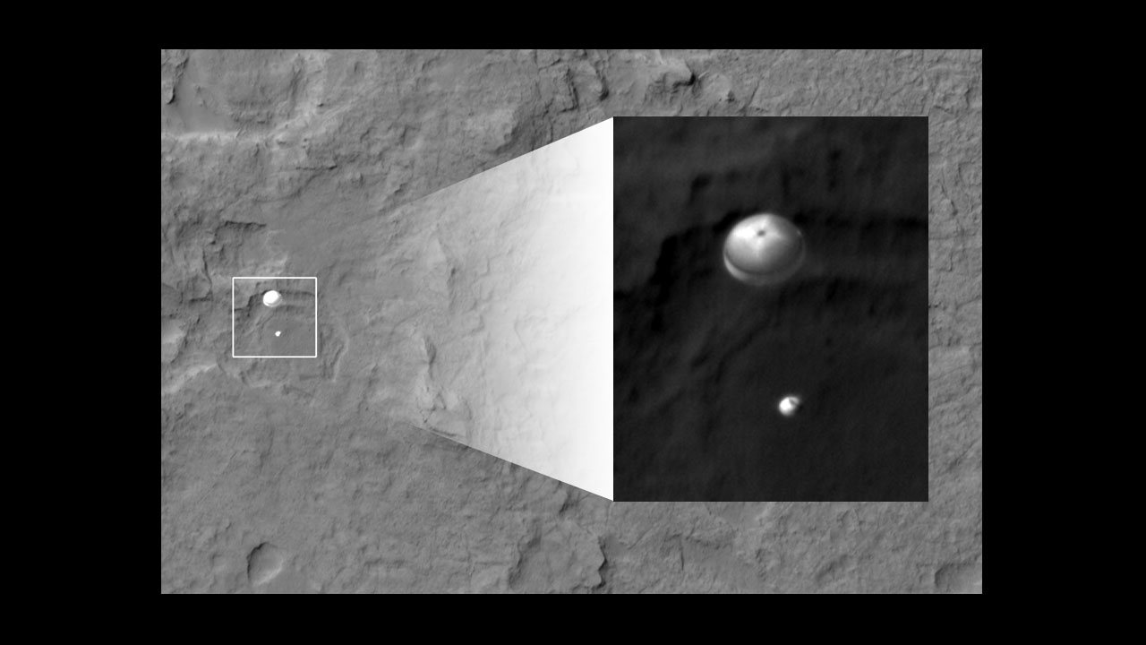
image credit: NASA/JPL

Slide 15
MSL mission goals:
Mission goals:
1.Determine whether Mars could ever have supported life
2.Study the climate of Mars
3.Study the geology of Mars
4.Plan for a human mission to Mars
...if anyone ever asks you:
We are not searching for life itself!

Slide 16
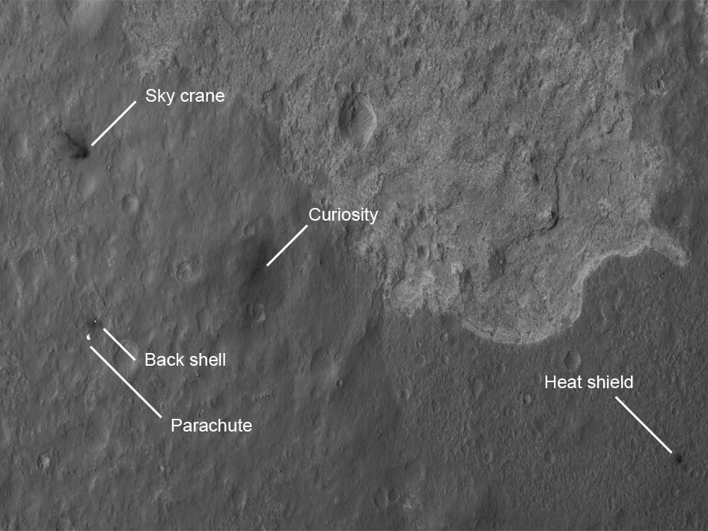
image credit: NASA/JPL

Slide 17
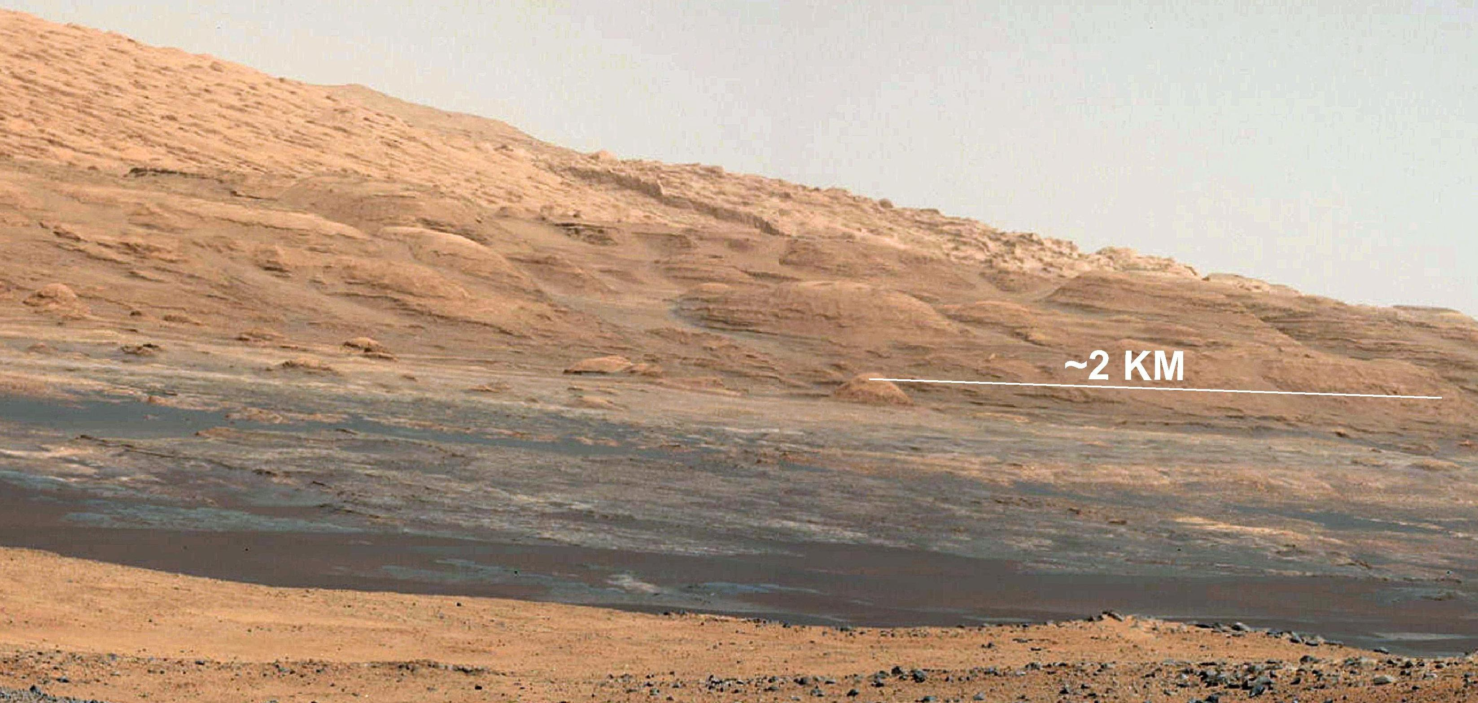
image credit: NASA/JPL

Slide 18
image credit: NASA/JPL

Slide 19
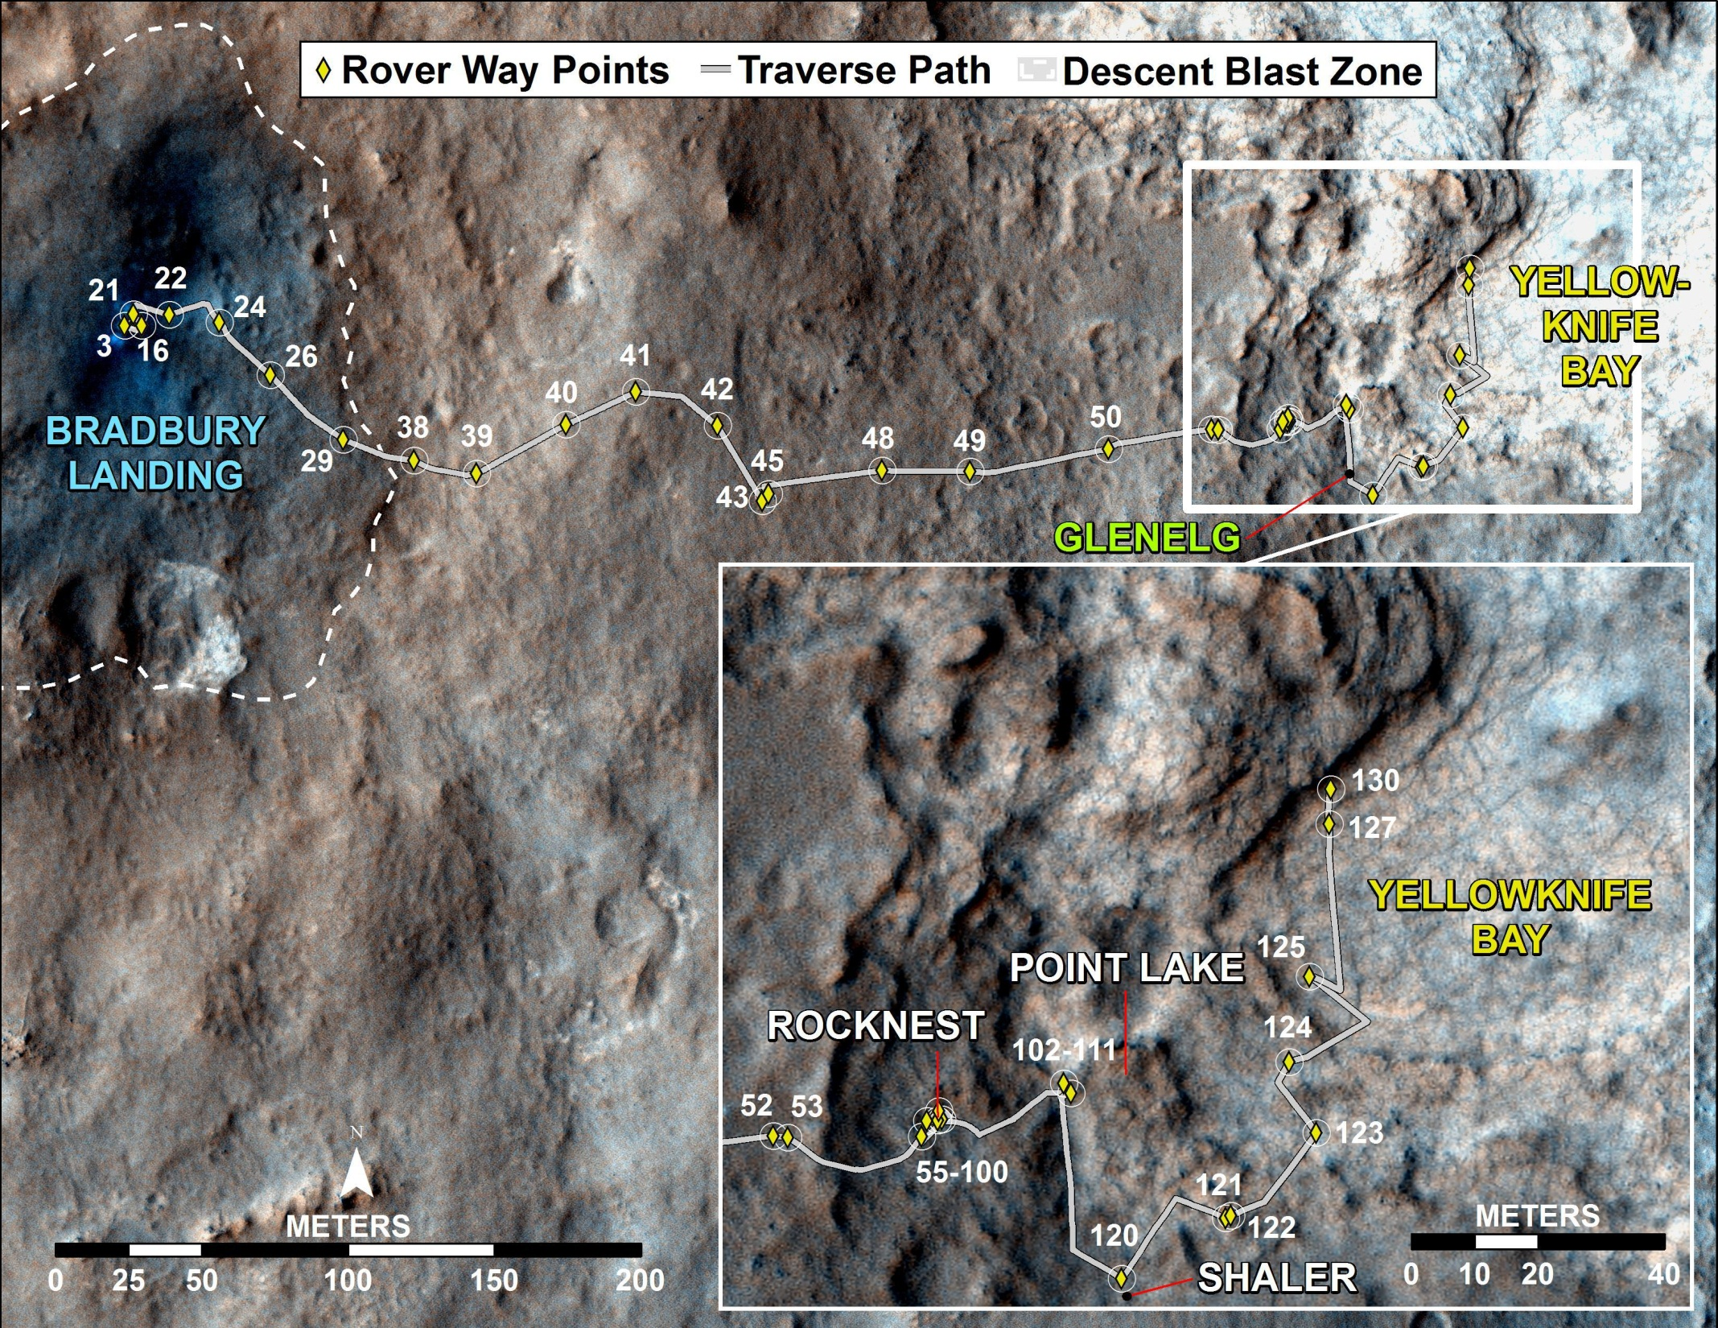
image credit: NASA/JPL

Slide 20
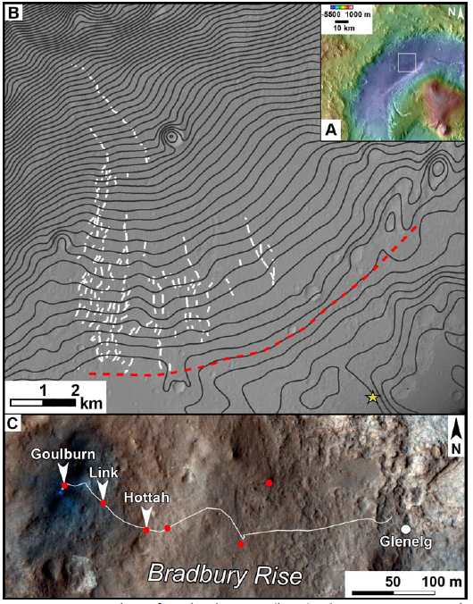
Location
Fan deposit observed from orbit
three outcrops
Williams et al. Science 2013
Fig. 1

Slide 21
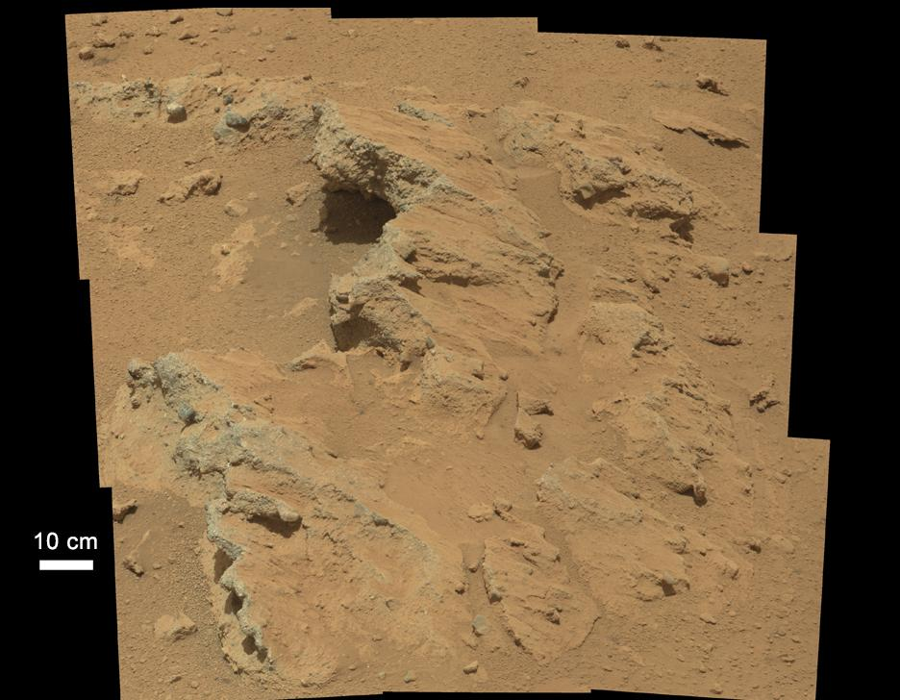
Hottah
sol 39
image credit: NASA/JPL

Slide 22
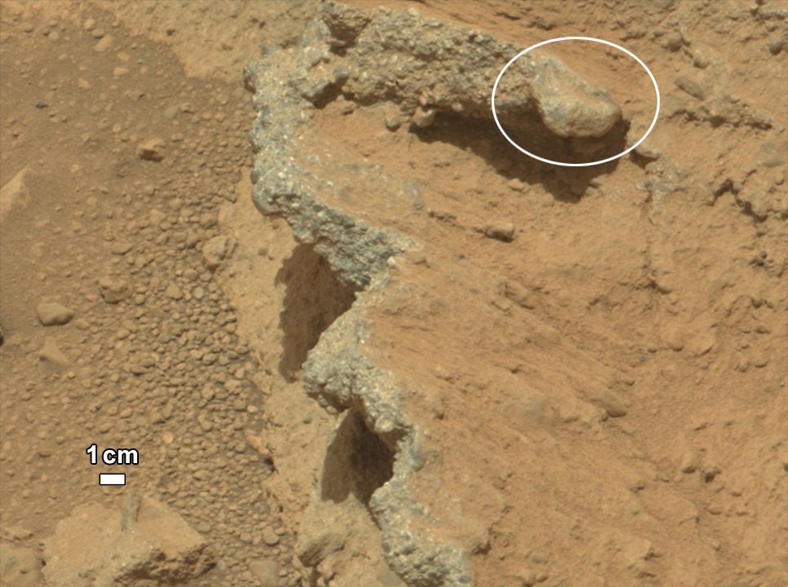
Hottah
sol 39
image credit: NASA/JPL

Slide 23
Goulburn Scour – exposed by rocket engines: fine-pebble conglomerate
Link is weakly stratifiedand ungraded conglomerate
Hottah has multi-coloured rounded pebbles.
Hottah
sol 39
image credit: NASA/JPL

Slide 24
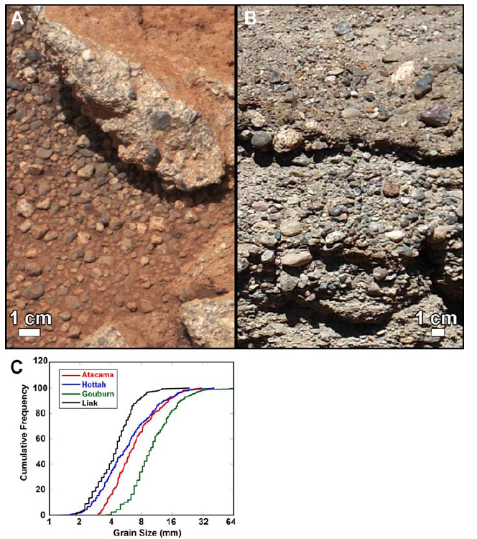
We can resolve grains as small as about 1 mm diameter
pebbles are 2-40 mm in diameter
Link outcrop
sol 27
Williams et al. Science 2013
Fig. 2

Slide 25
Results:
It is the first time ROUNDED clasts are found on Mars!
sorted, stratified sediment that typify fluvial deposits
ChemCam finds feldspar - indicative of not much alteration
indicative of rapid speed movement with many collisions
probably several kilometer transport distance
0.03-0.9 m depth; 0.2-0.75 m/s average velocity to mobilize the observed grain size for a range of slopes (0.1%-1%)
Williams et al., Science 2013

Slide 26
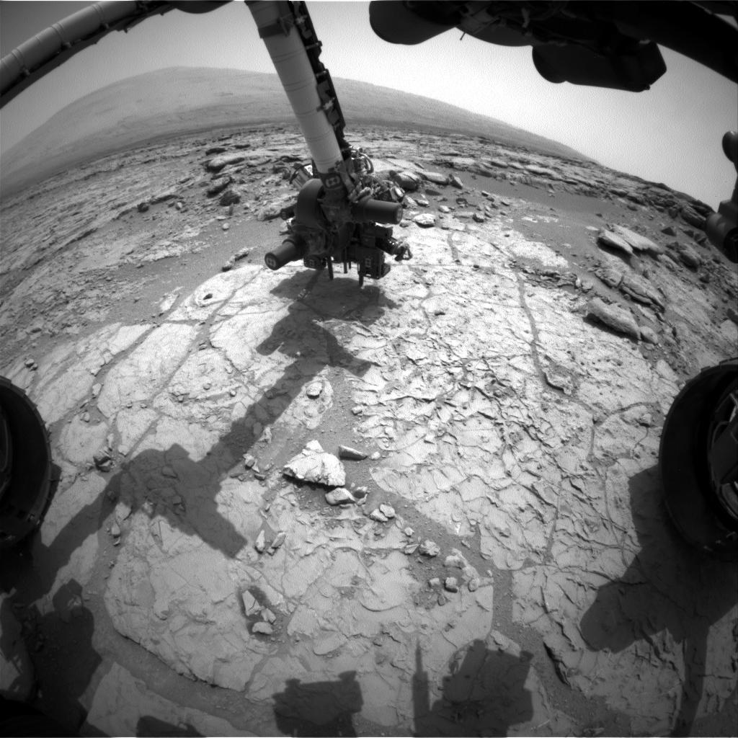
170th Martian sol,
(Jan. 27, 2013)
drill in position
"John Klein"
at Yellowknife Bay
image credit: NASA/JPL

Slide 27
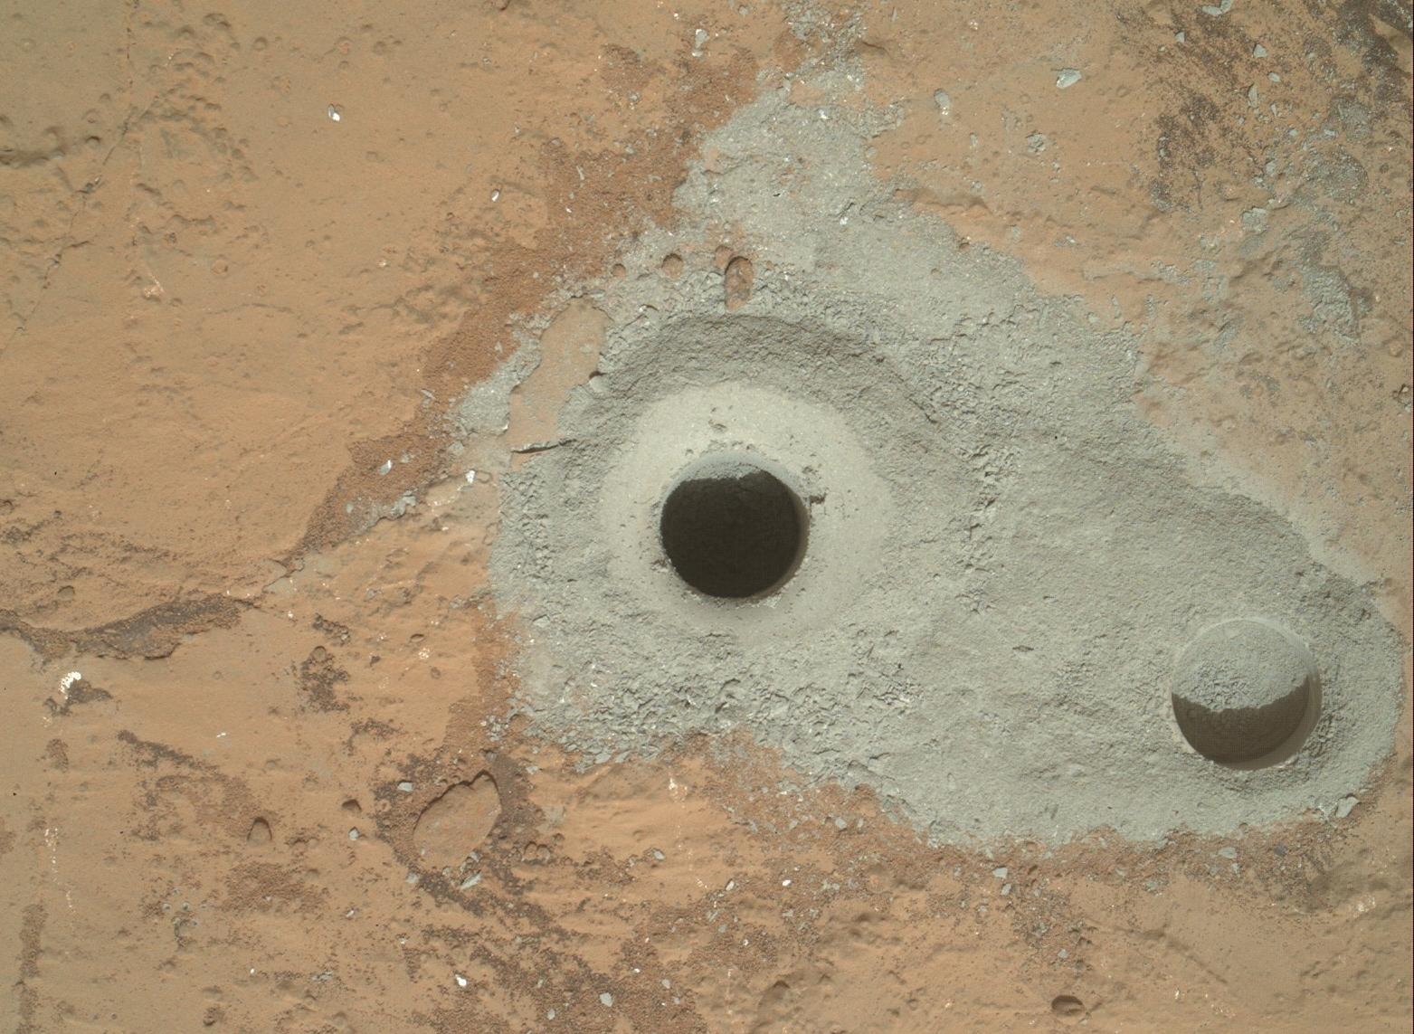
image credit: NASA/JPL

Slide 28
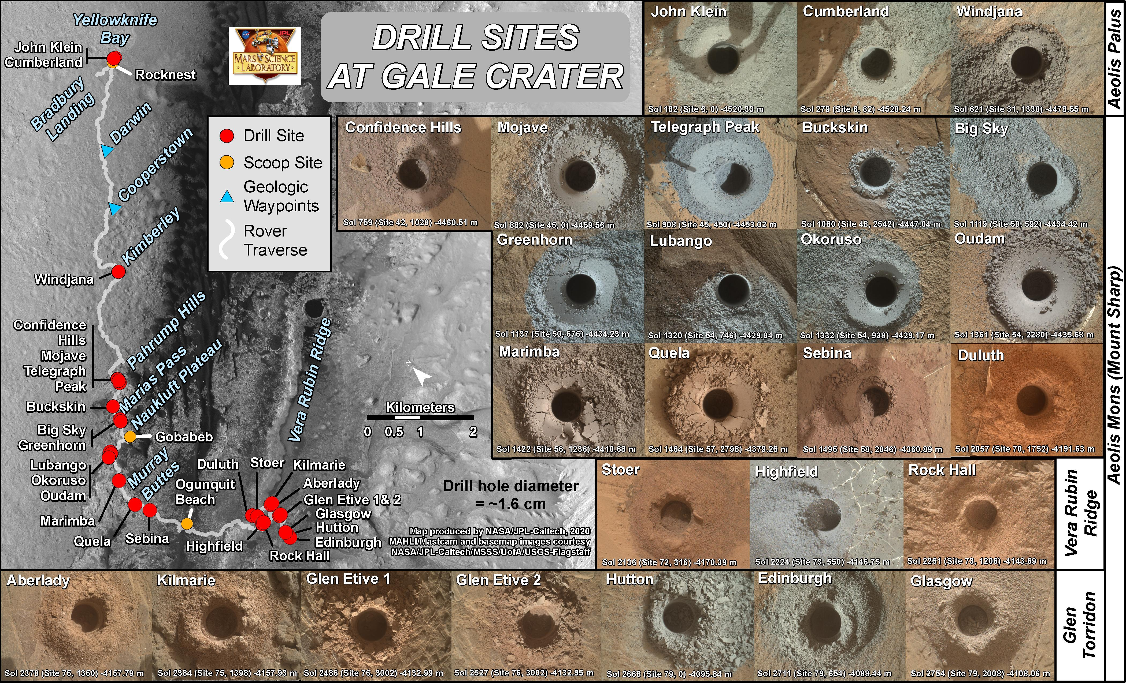
image credit: NASA/JPL

Slide 29
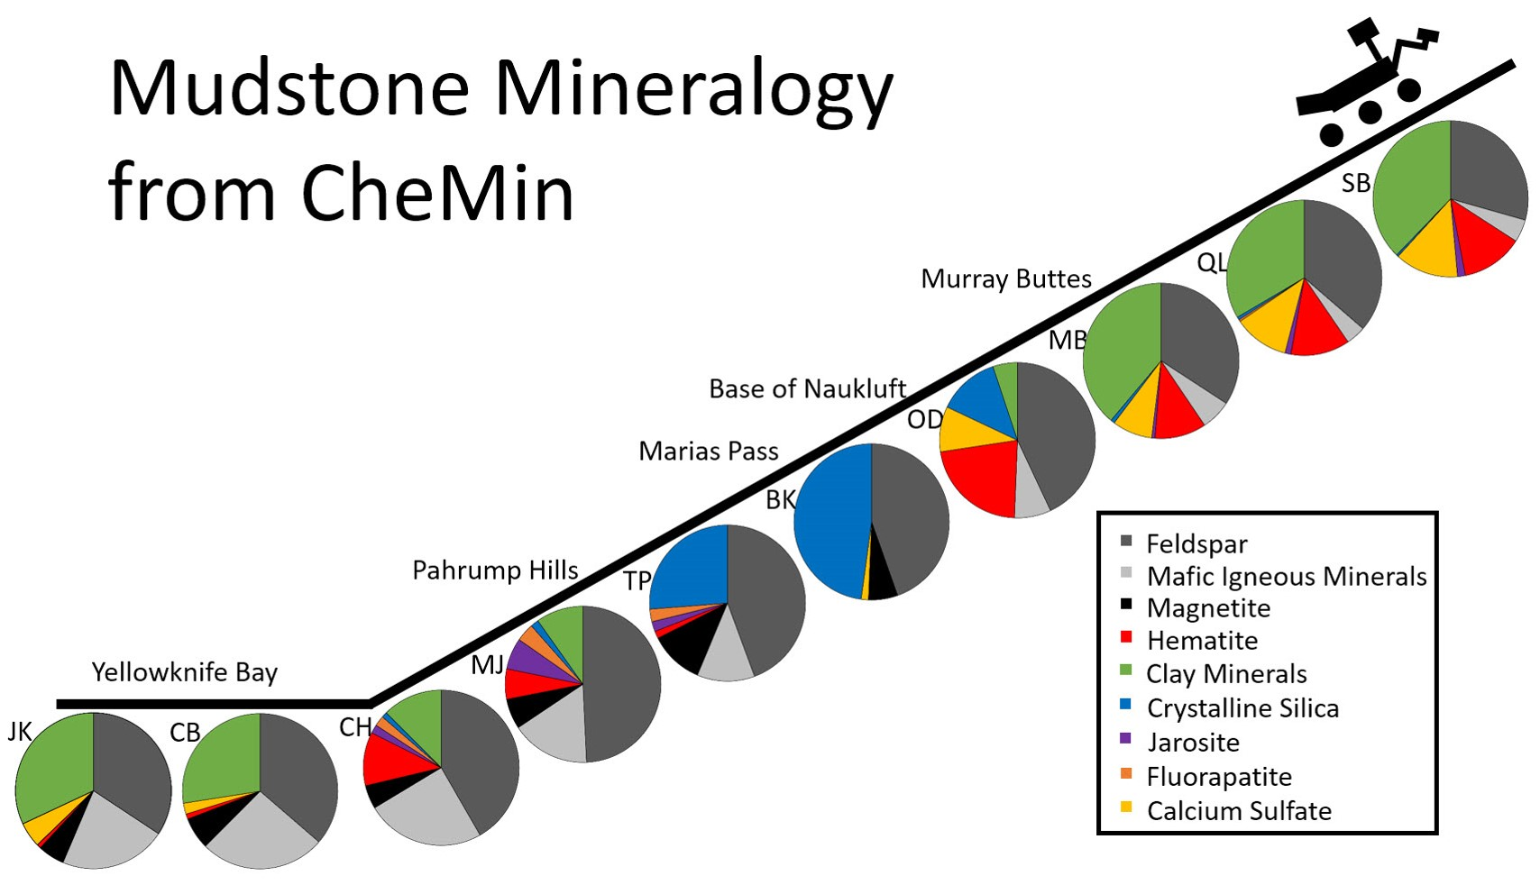
Drill results
image credit: NASA/JPL/Liz Rampe

Slide 30
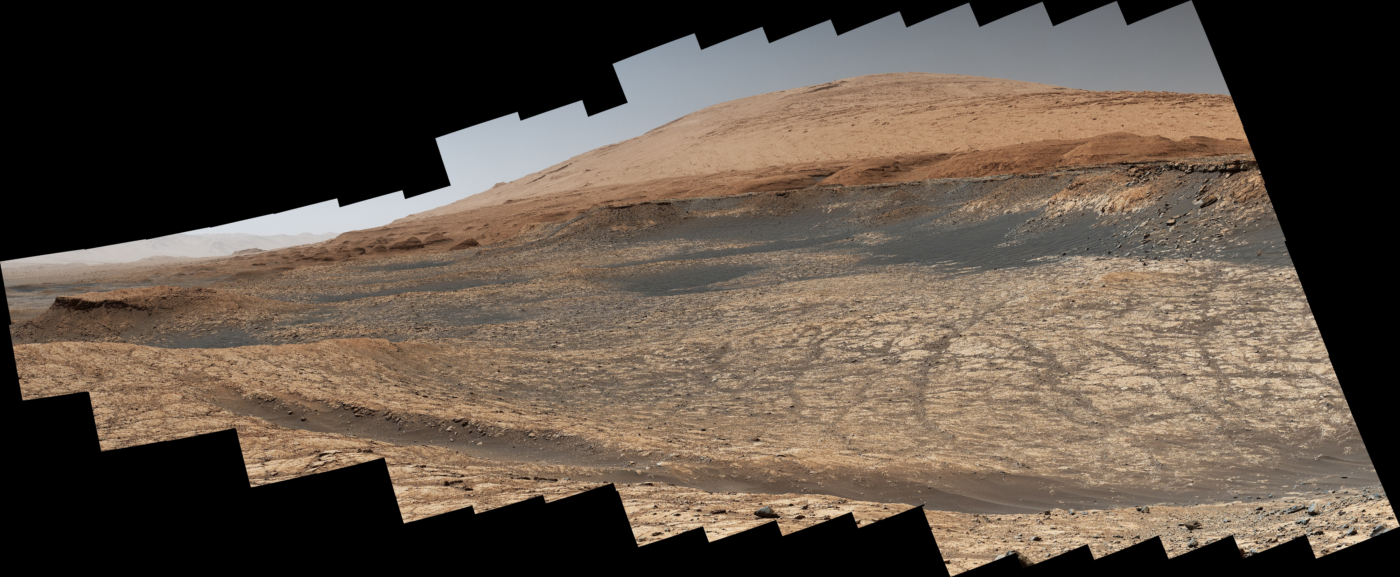
Clay bearing unit and Greenheugh Pediment
Image credit: NASA/JPL

Slide 31
Sol 1555, Old Soaker
Potential mudcracks
MastCam; image credit: NASA/JPL

Slide 32
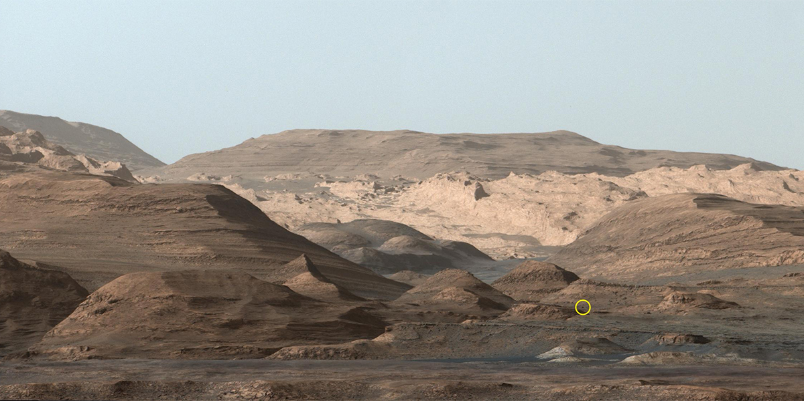
'Paraitepuy Pass' From a Distance
Circle indicates rover sized boulder, Image taken 15th August 2015, rover drove past that boulder in August 2022
MastCam; image credit: NASA/JPL

Slide 33
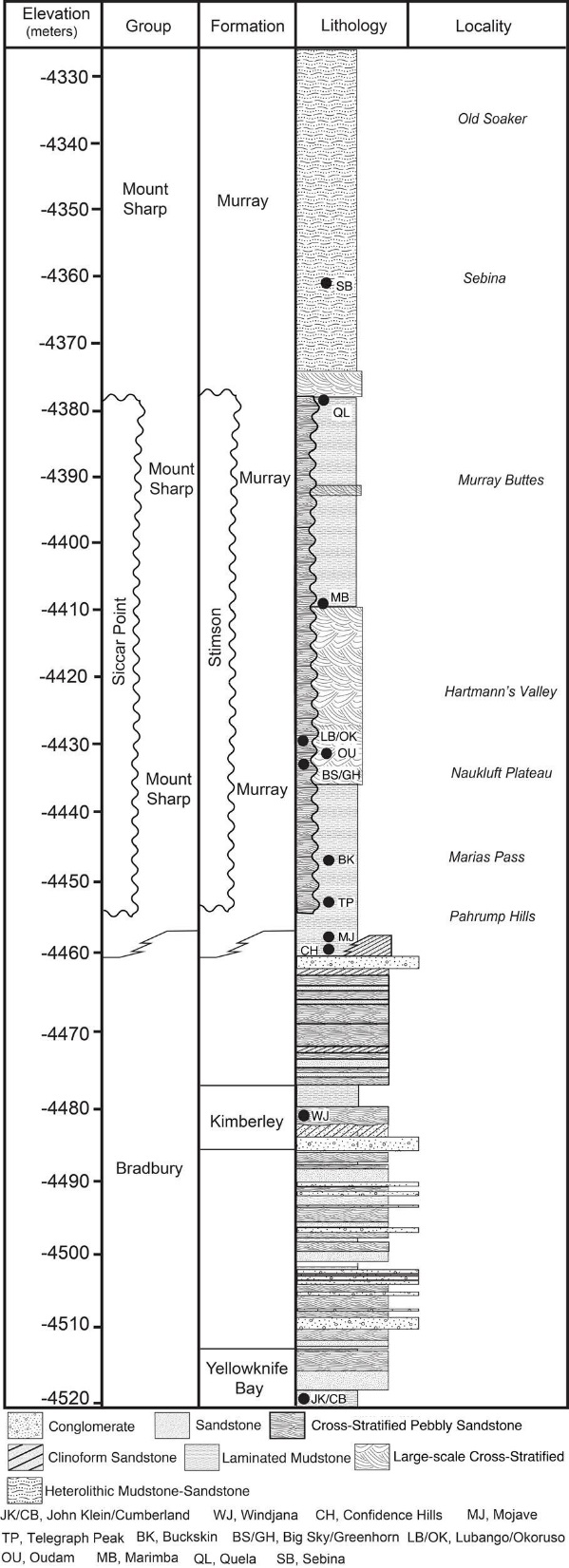
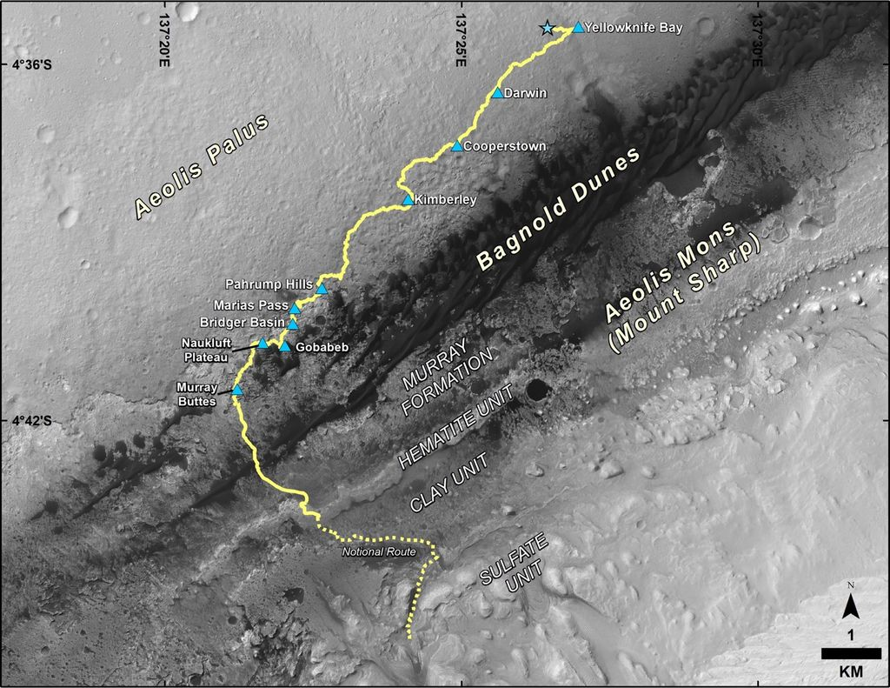
Stratigraphy, planetary history written in stone
Curiosity has travelled > 25 km and analysed > 200 m of Martian stratigraphic history
Grotzinger et al. (2014, 2015)

Slide 34
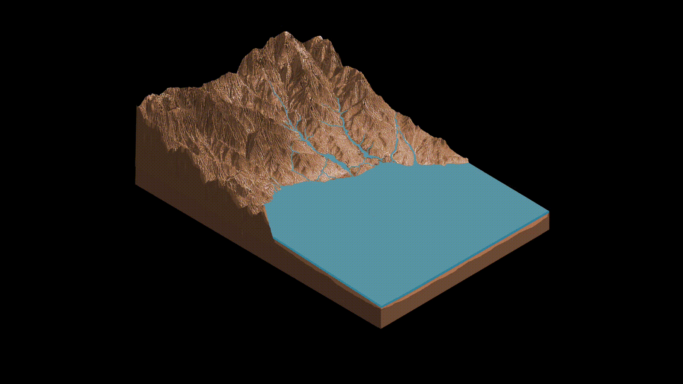
Sutton Island model … a drying lake on Mars

Slide 35
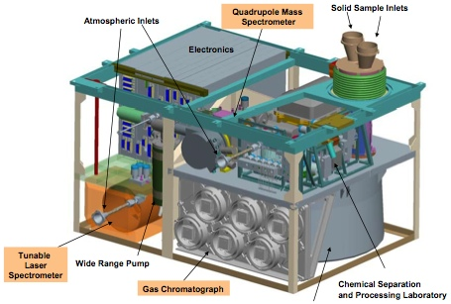
Sample Analyzer at Mars (SAM)
image credit: NASA/JPL

Slide 36
Previous detections
Krasnopolski et al. (2004): 10 ±3 ppbv, ground-based observations from the Canada-France-Hawaii Telescope (CFHT) in 1999
Etiope et al. (2011): release in plumes and seasonal changes, maximum of ~45 ppbv, NASA IRTF telescope in 2003; discrete sources in Terra Sabae, Nili Fossae, and Syrtis Major; but down to 3 ppbv in 2006, rapid destruction?
Mumma et al. (2009) and Geminale et al. (2011): detections of plumes
Formisano et al. (2004): 15 ±5 ppbv; Planetary Fourier Spectrometer (PFS) on the Mars Express (MEX) spacecraft, localized sources, and a summer time maximum of 45 ppbv in the north polar region.
Fonti and Marzo (2010): 5 to 60 ppbv ; Thermal Emission Spectrometer (TES) of Mars Global Surveyor (MGS), intermittentl
Villanueva et al. (2013): 10 ppbv ; NASA-IRTF acquired in February 2006, over Valles Marineris but an upper limit of 3 ppbv outside that region; in December 2009 upper limit of 7-8 ppbv
Krasnopolski (2011, 2012): upper limit of 5 ppbv; groundbased observations

Slide 37
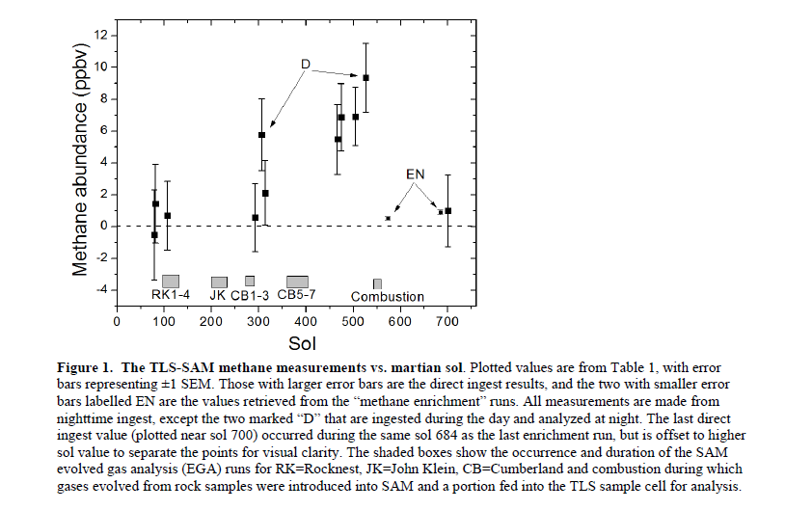
Methane at Gale Crater
7.19±2.06
0.69±0.25
Webster et al., Science, December 2014

Slide 38
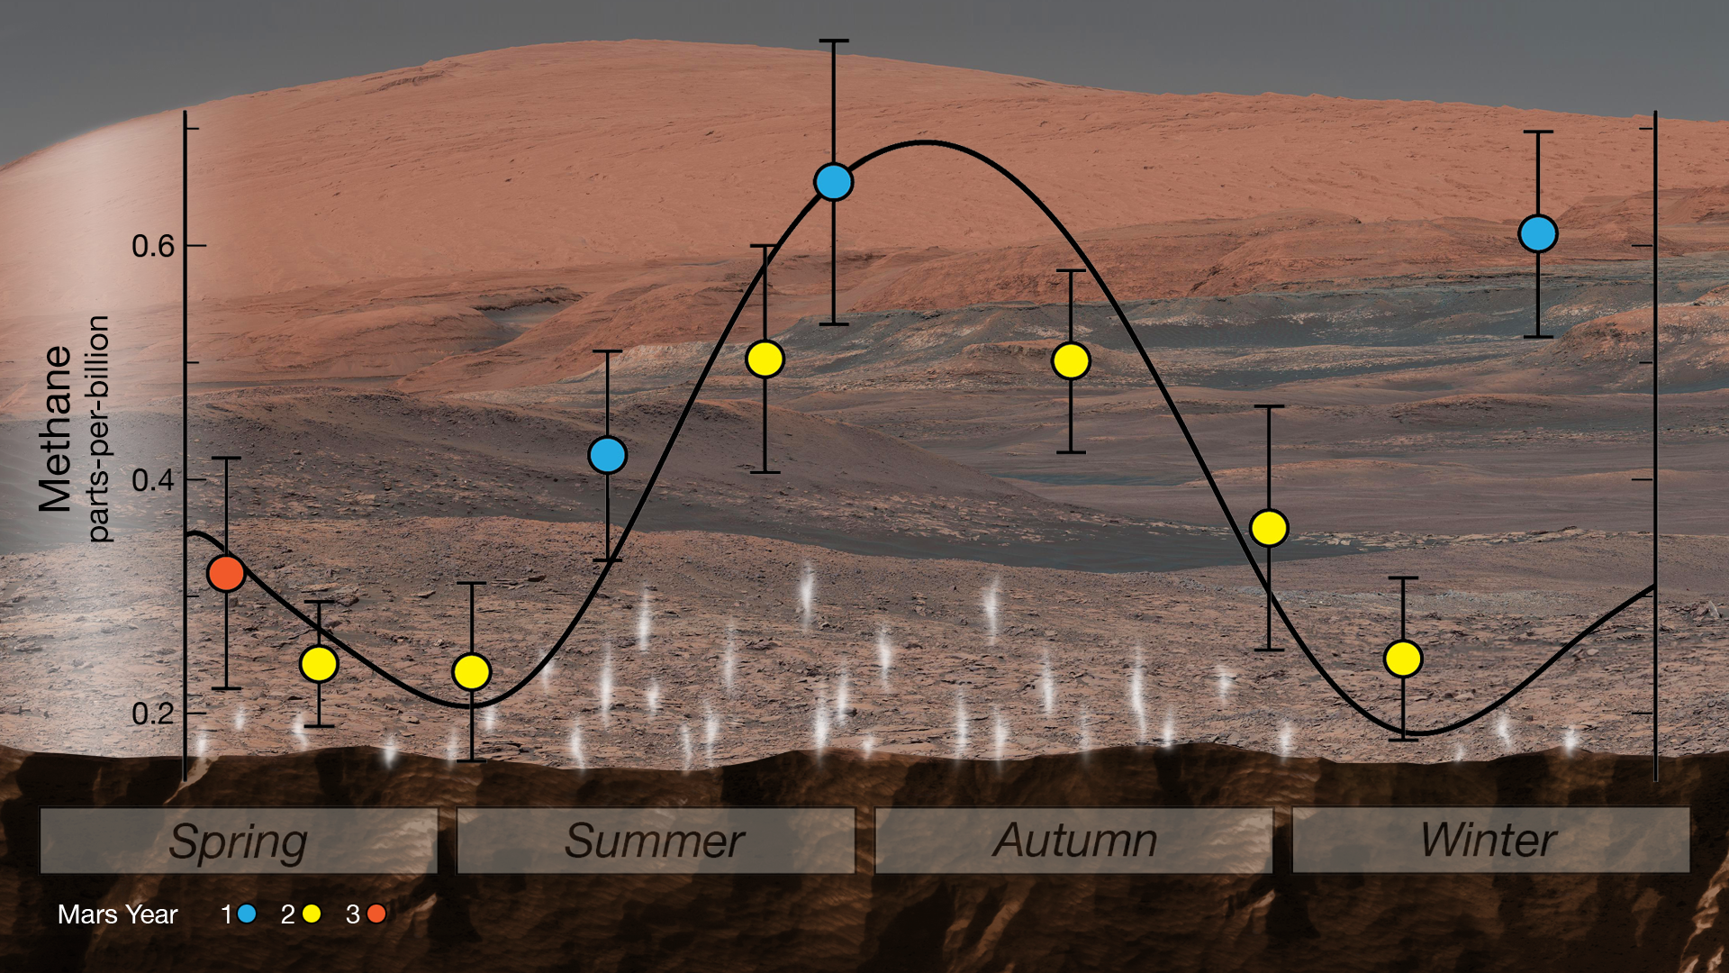
Methane variations
image credit: NASA/JPL

Slide 39
Methane at Gale.....
image credit: NASA/JPL

Slide 40
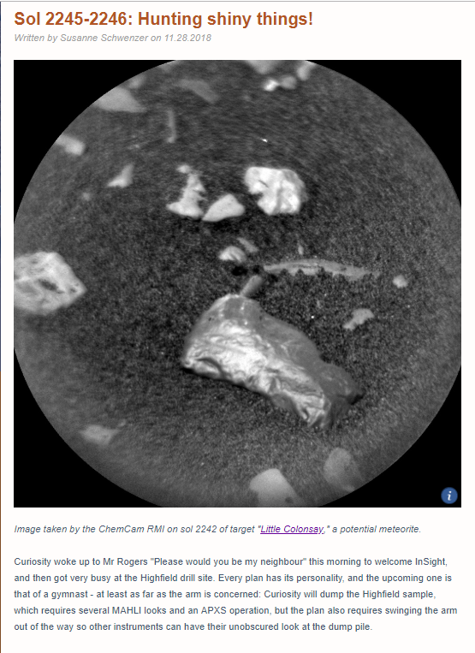
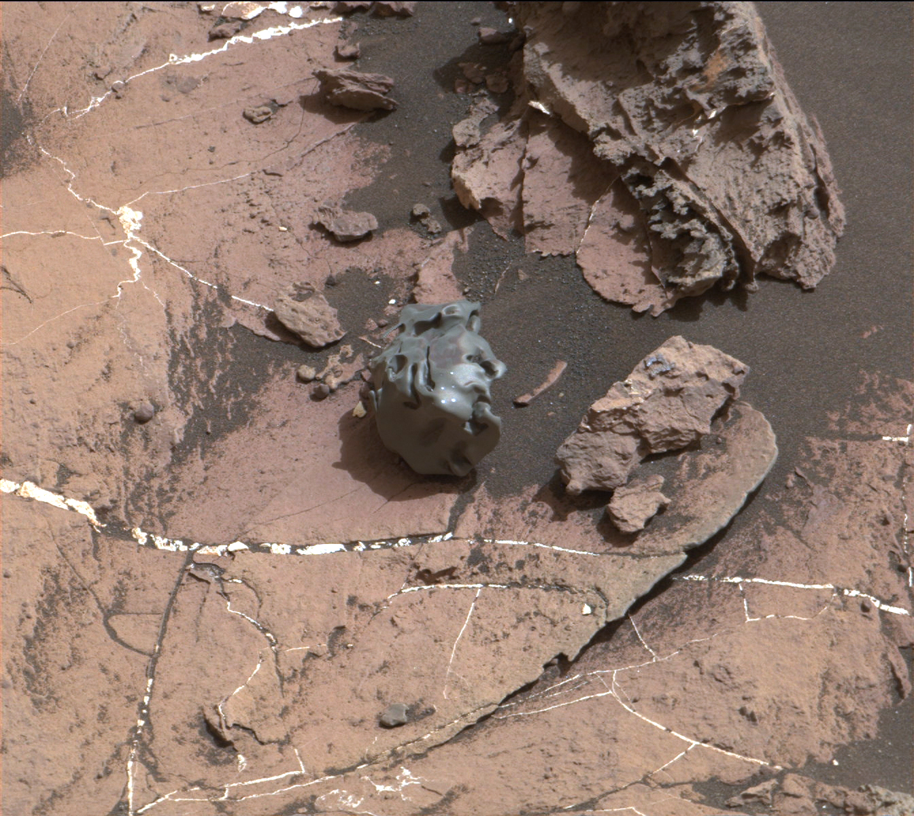
Egg rock, October 2016
https://mars.nasa.gov/msl/mission/mars-rover-curiosity-mission-updates/
Sol 1635, MastCam

Slide 41
Martian atmosphere… dust devils on Mars

Slide 42
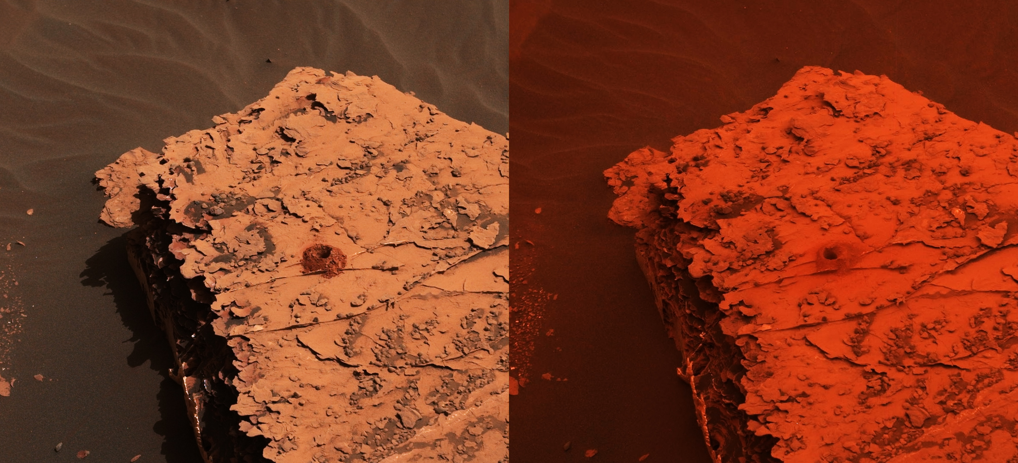
Martian dust storm season
Image credit: NASA/JPL

Slide 43
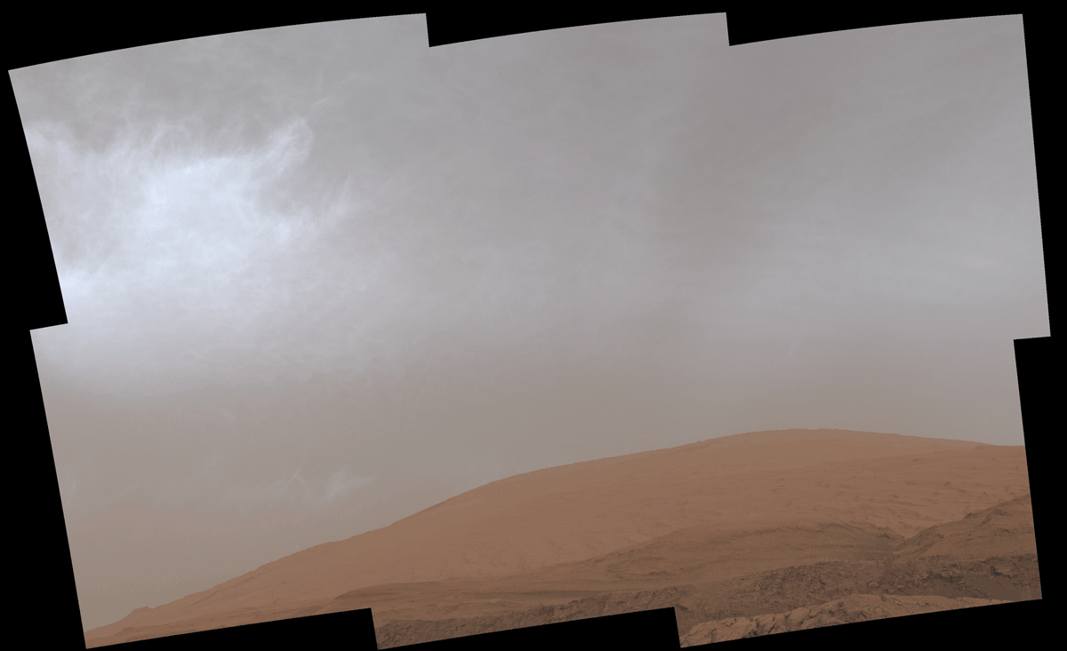
Clouds over Mt Mercou
Image credit: NASA/JPL, https://mars.nasa.gov/resources/25946/curiosity-gif-shows-drifting-clouds-over-mars-mount-sharp/?site=msl

Slide 44
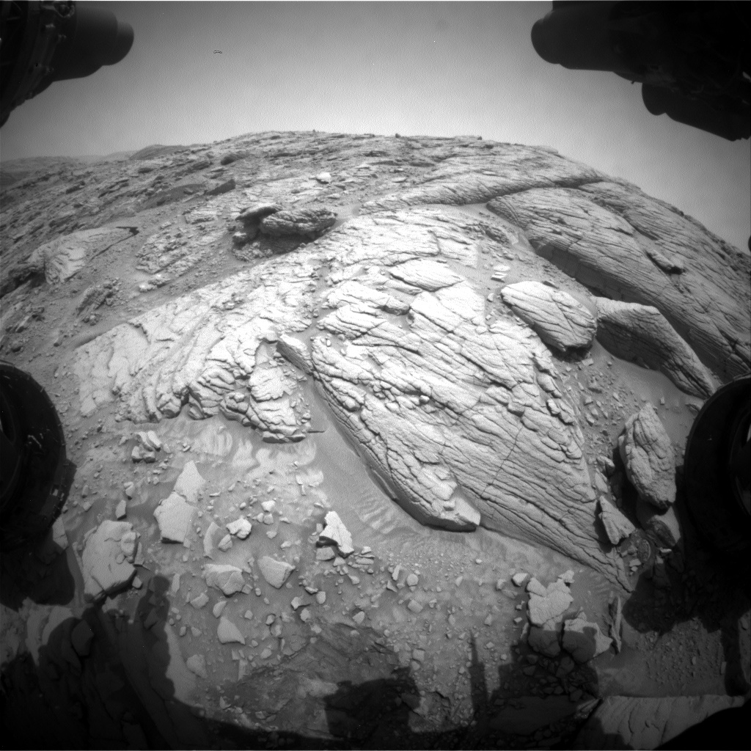
https://mars.nasa.gov/raw_images/1146086?site=msl
Sol 3655: Front Hazard Avoidance Camera (Front Hazcam)

Slide 45
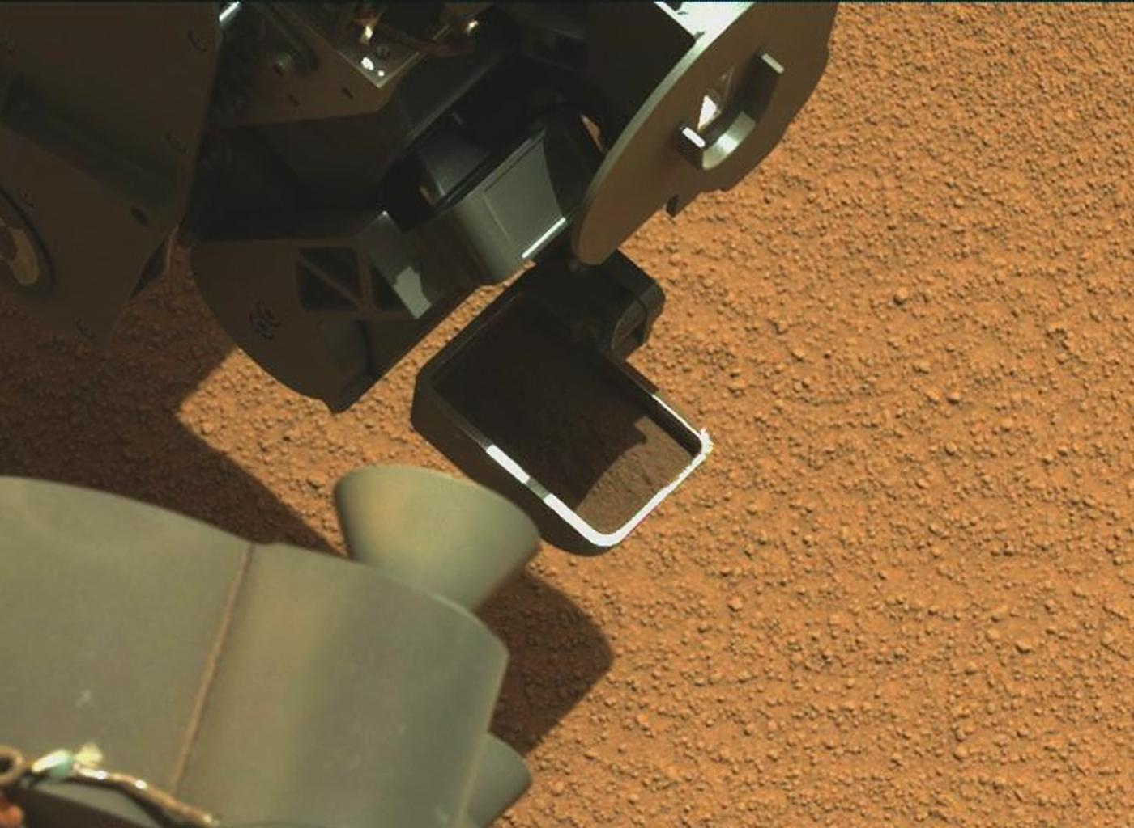
sol 89, Rocknest
image credit: NASA/JPL

Slide 46
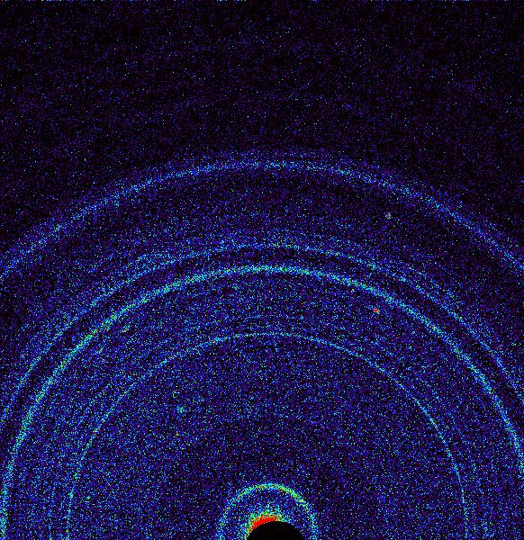
image credit: NASA/JPL
sol 71, Rocknest

Slide 47
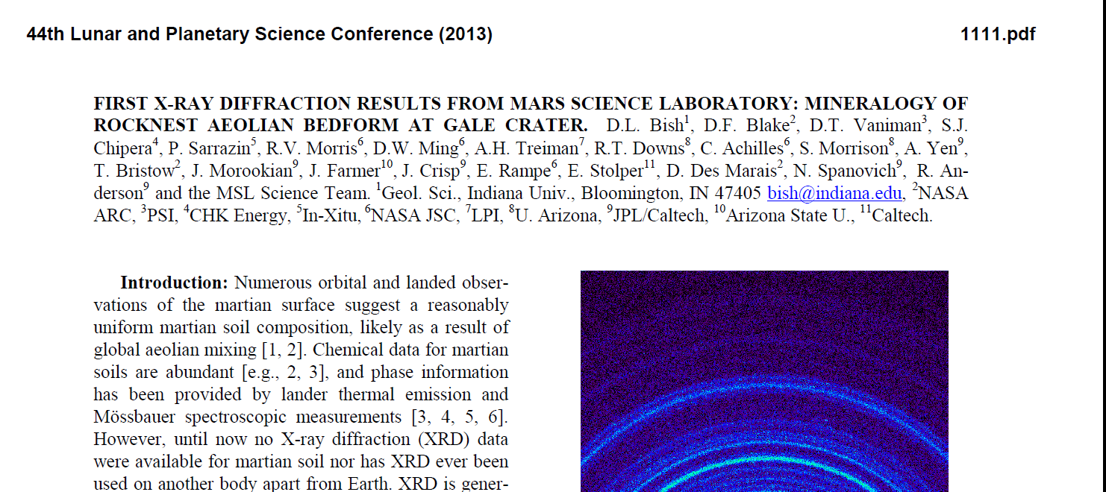
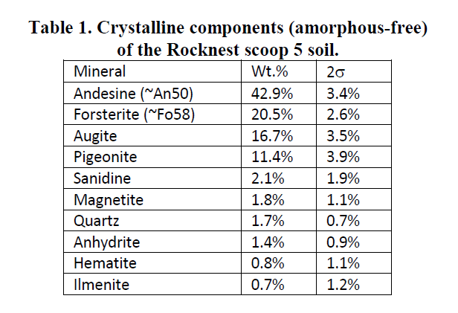
Bish et al., Science 341, September 2013

Slide 48
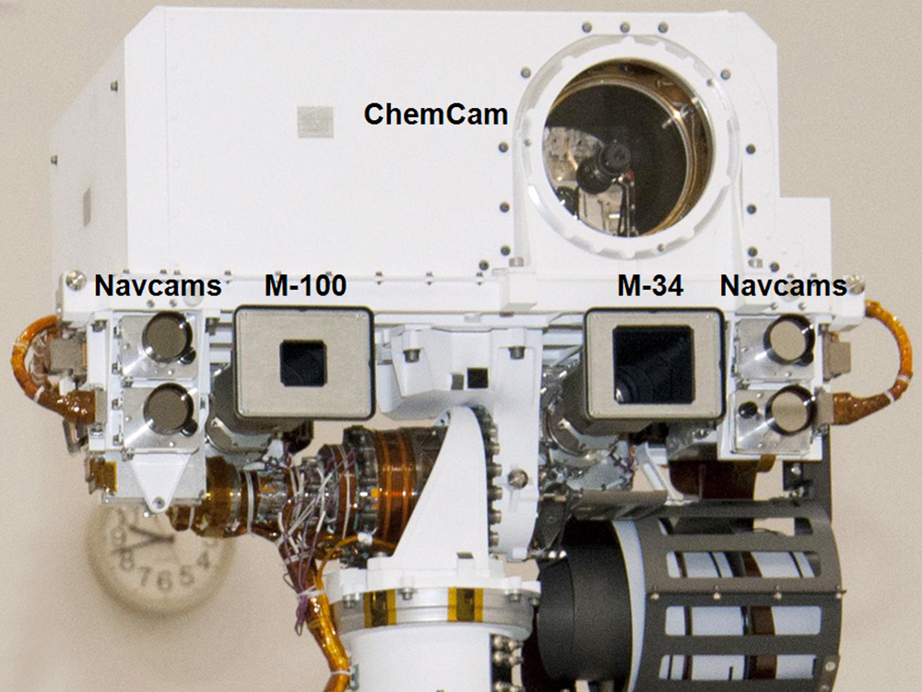
image credit: NASA/JPL

Slide 49
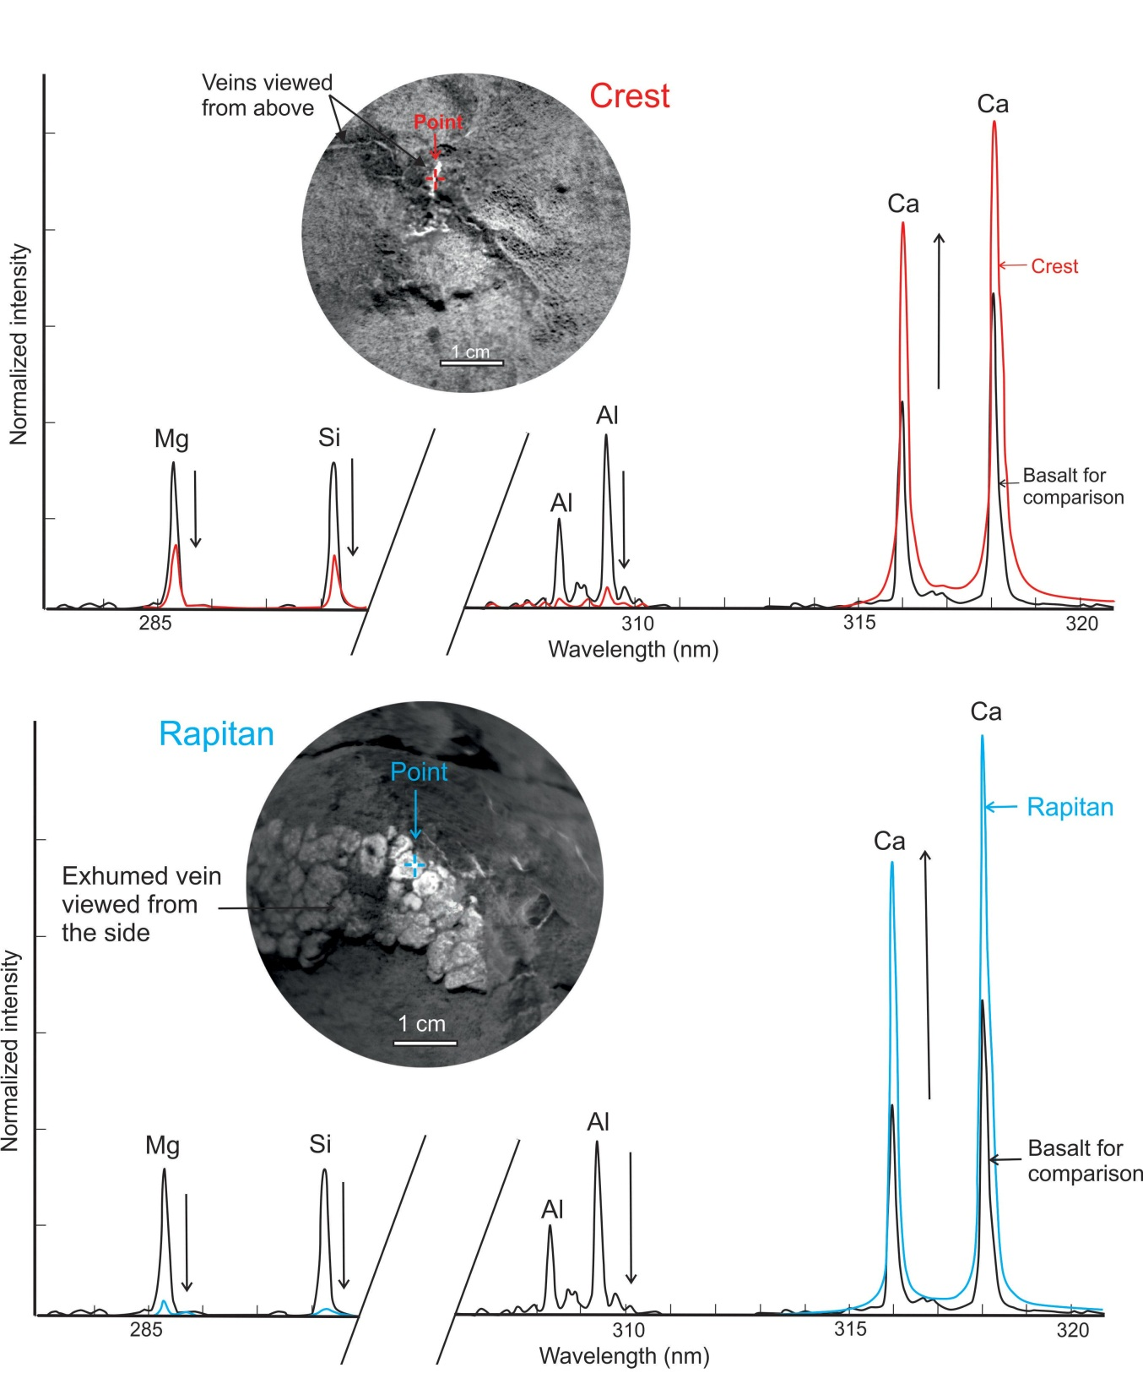
ChemCam discovers
Ca-sulfate
image credit: NASA/JPL

Slide 50
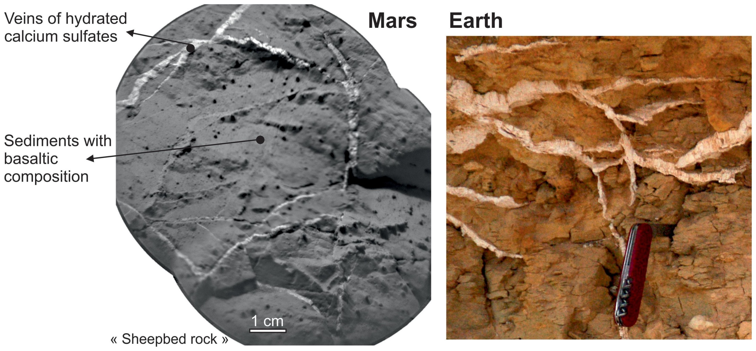
sol 126, Sheepbed
image credit: NASA/JPL

Slide 51
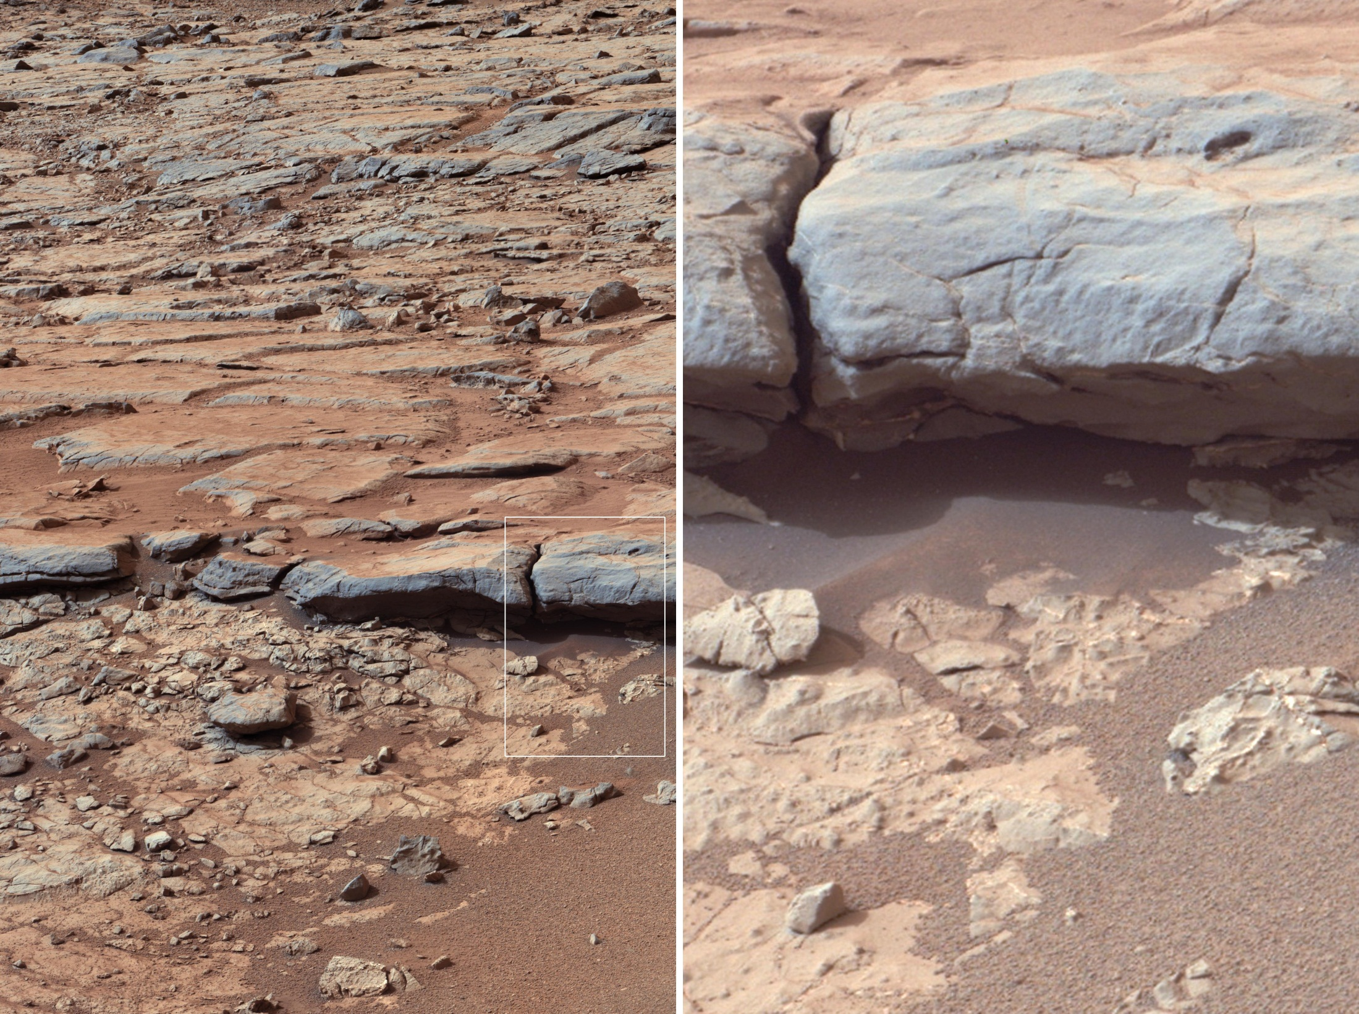
image credit: NASA/JPL

Slide 52
170th Martian sol,
(Jan. 27, 2013)
drill in position
"John Klein"
at Yellowknife Bay
image credit: NASA/JPL

Slide 53
image credit: NASA/JPL

Slide 54
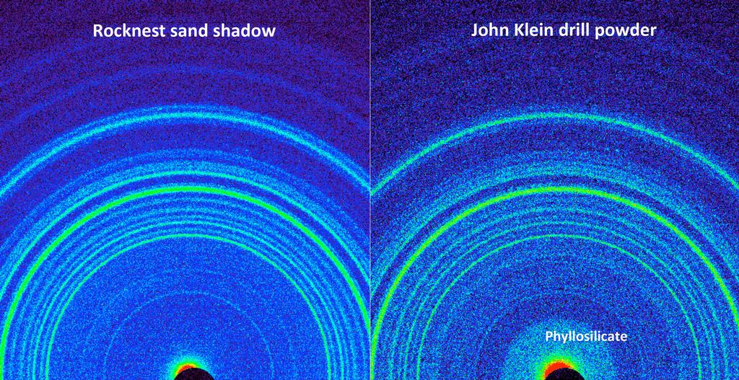
image credit: NASA/JPL

Slide 55
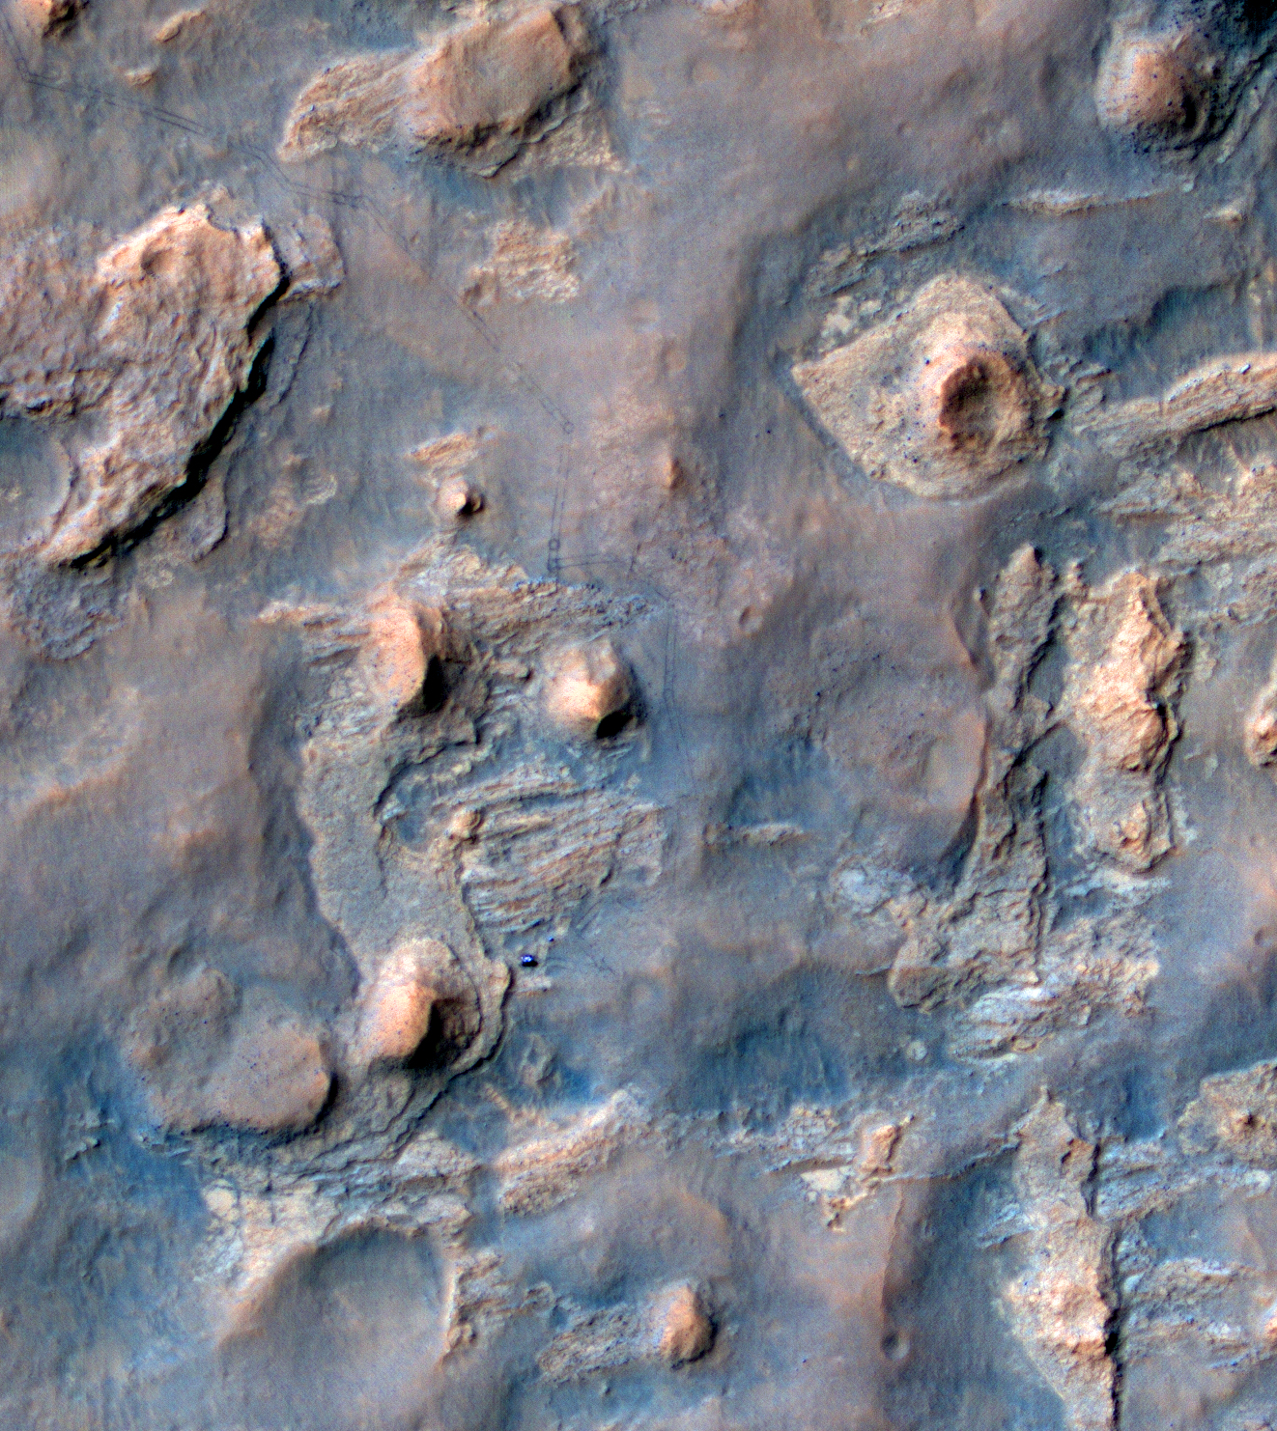
Keeping track -
Curiosity as
imaged
by HiRISE
at 'The Kimberly'
drill location
from orbit

Slide 56
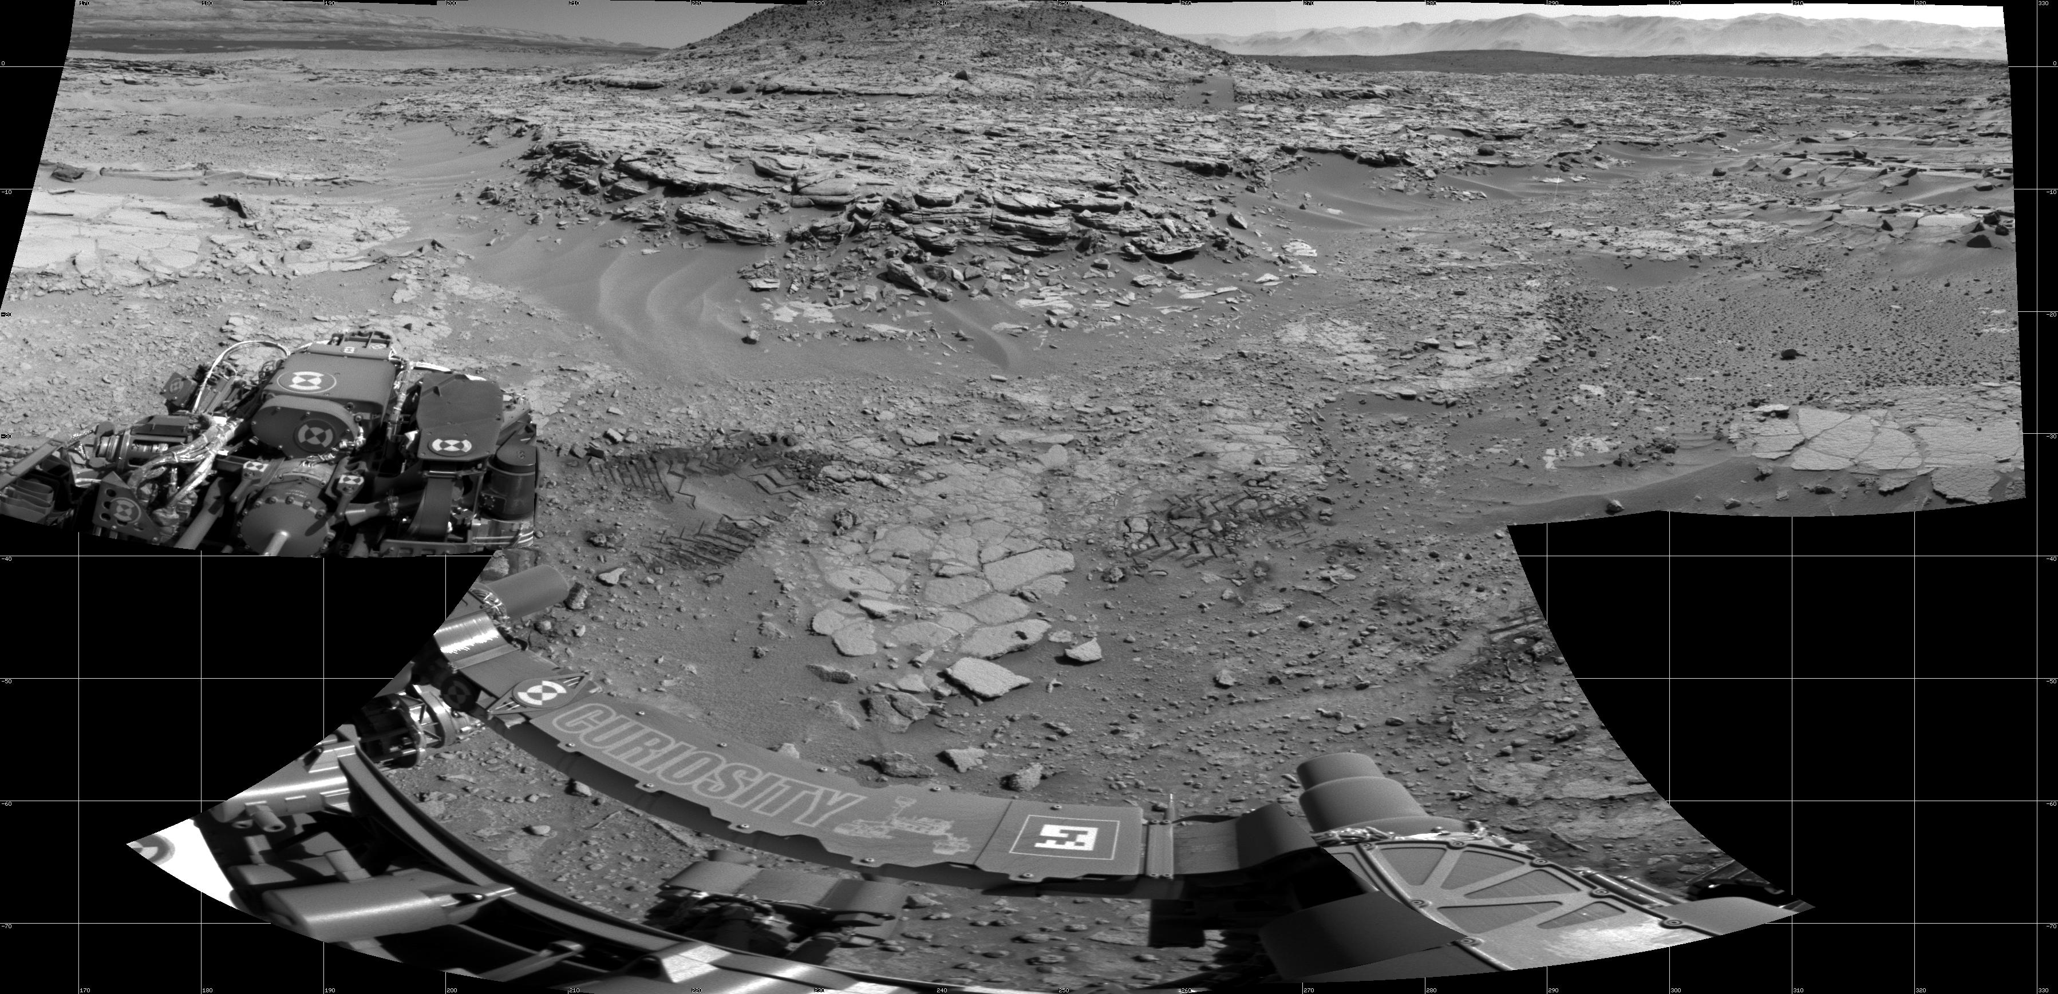
at 'The Kimberly'
drill location from the ground

Slide 57
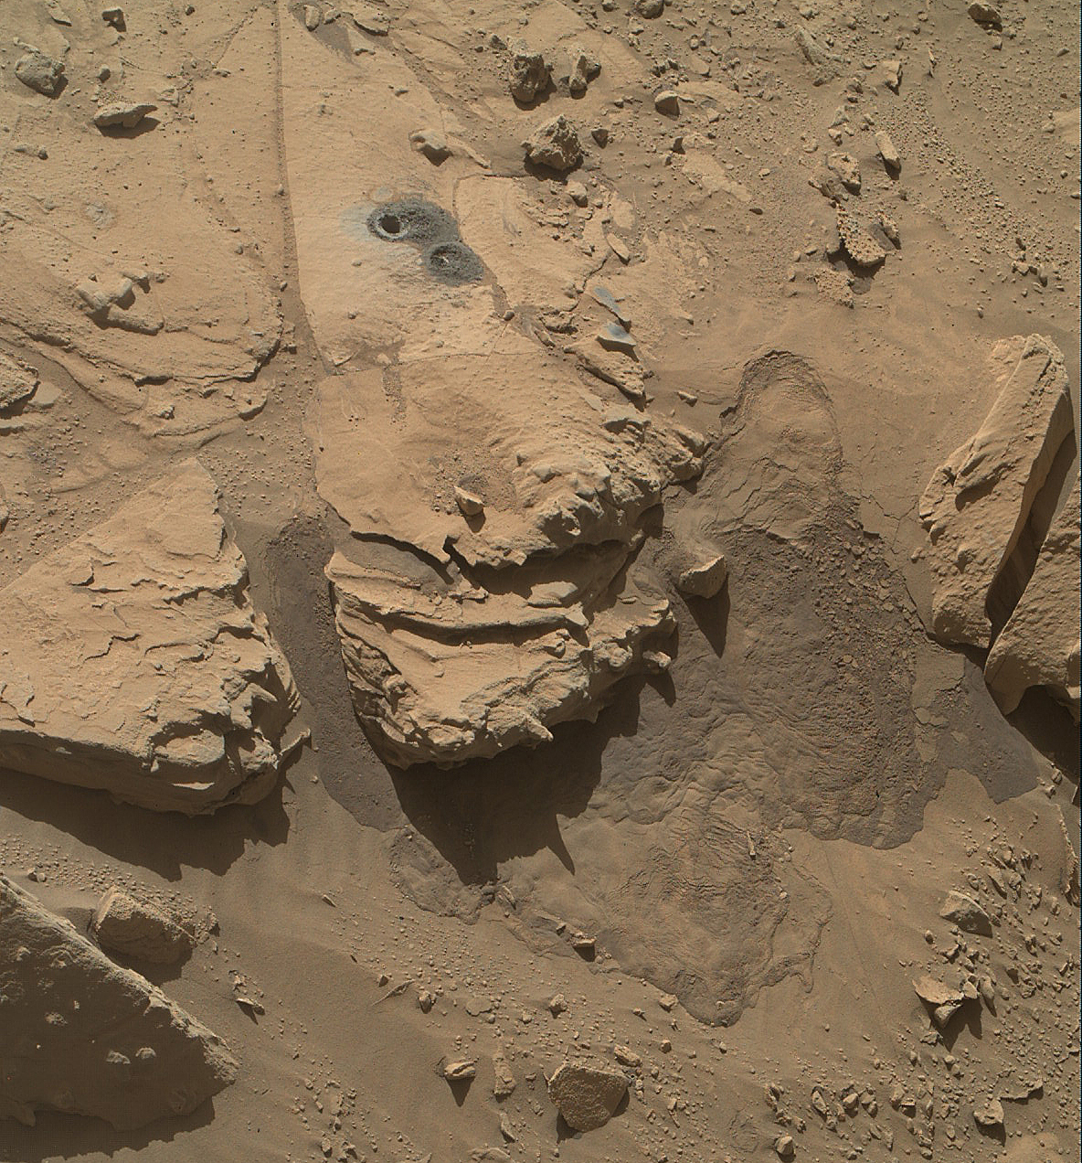
The Kimberly
after drilling
Windjana target

Slide 58
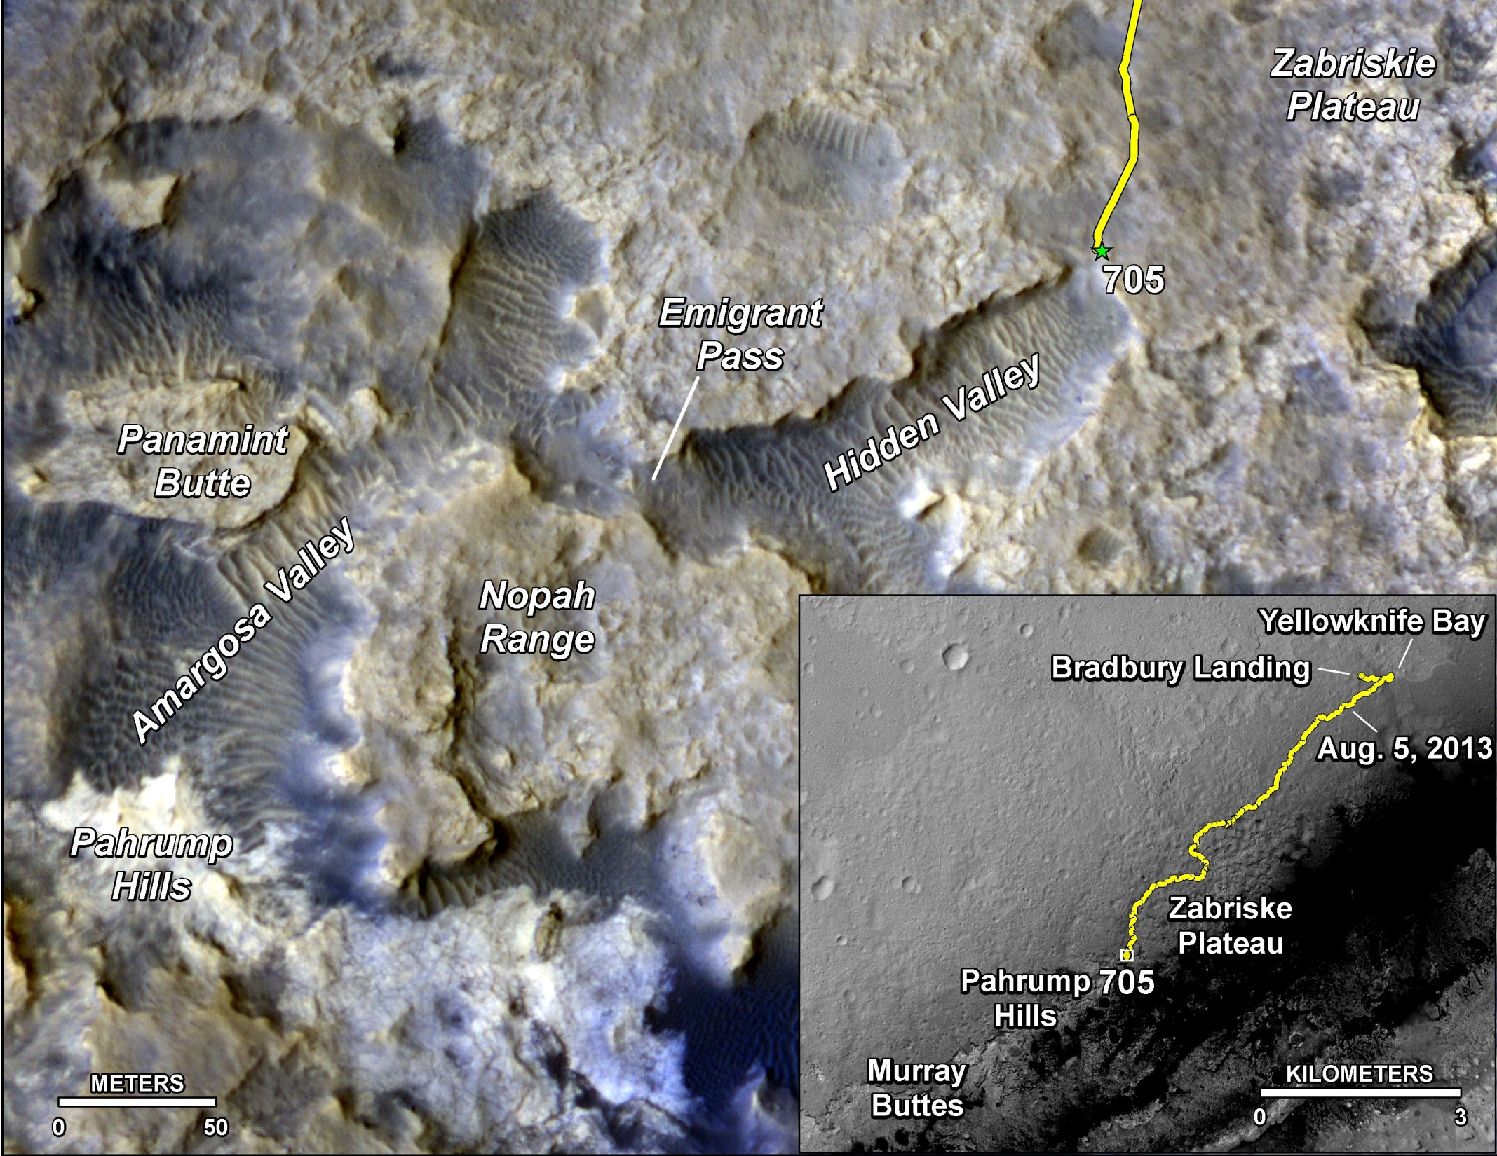

Slide 59
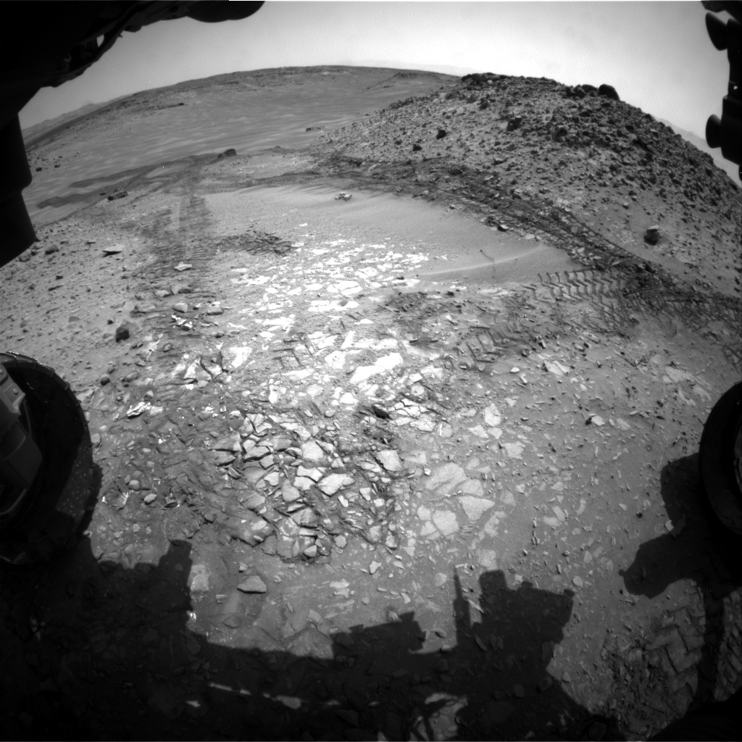
Hidden
Valley

Slide 60
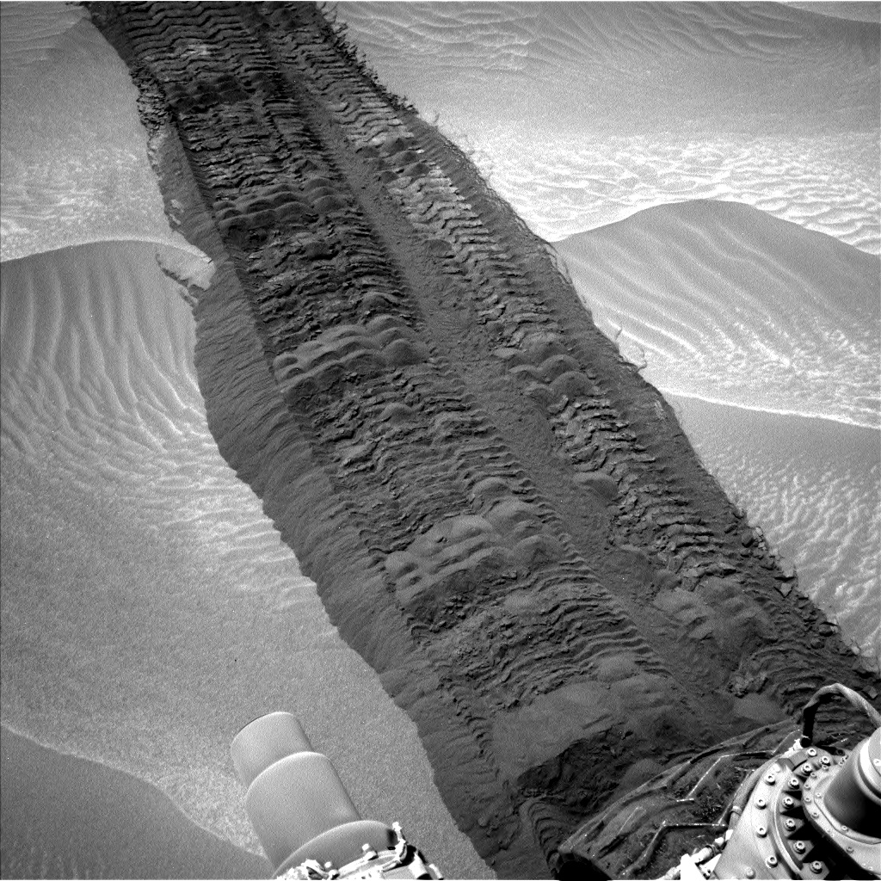
Hidden
Valley

Slide 61
Pahrump
Hills
Confidence Hills
target

Slide 62
Pahrump
Hills
Confidence Hills
target
Image:NASA/JPL

Slide 63
Mojave target

Slide 64
Buckskin selfie

Slide 65
Mt Sharp

Slide 67
MER rovers:
Mars Rover Opportunity - Mars Missions - NASA Jet Propulsion Laboratory
Curiosity rover:
Home | Curiosity – NASA Mars Exploration
Perseverance rover:
Mars 2020 Perseverance Rover - NASA Mars
Viking mission:
Viking 1 & 2 | Missions – NASA Mars Exploration
Planetary Photo Journal:
Photojournal: NASA's Image Access Home Page
Planet Mars:
Overview | Mars – NASA Solar System Exploration
Mars Resources – NASA Solar System Exploration
Mars for Educators - NASA Mars
Thank you
Dingo Gap, sol 538, Image:NASA/JPL

