Slide 1
PLANETARY GEOLOGY
Lecture 5 – Terrestrial Analogues for planetary exploration
Fulvio Franchi, PhD
Dipartimento di Scienze della Terra e Geoambientali, Università di Bari – Aldo Moro

Slide 2
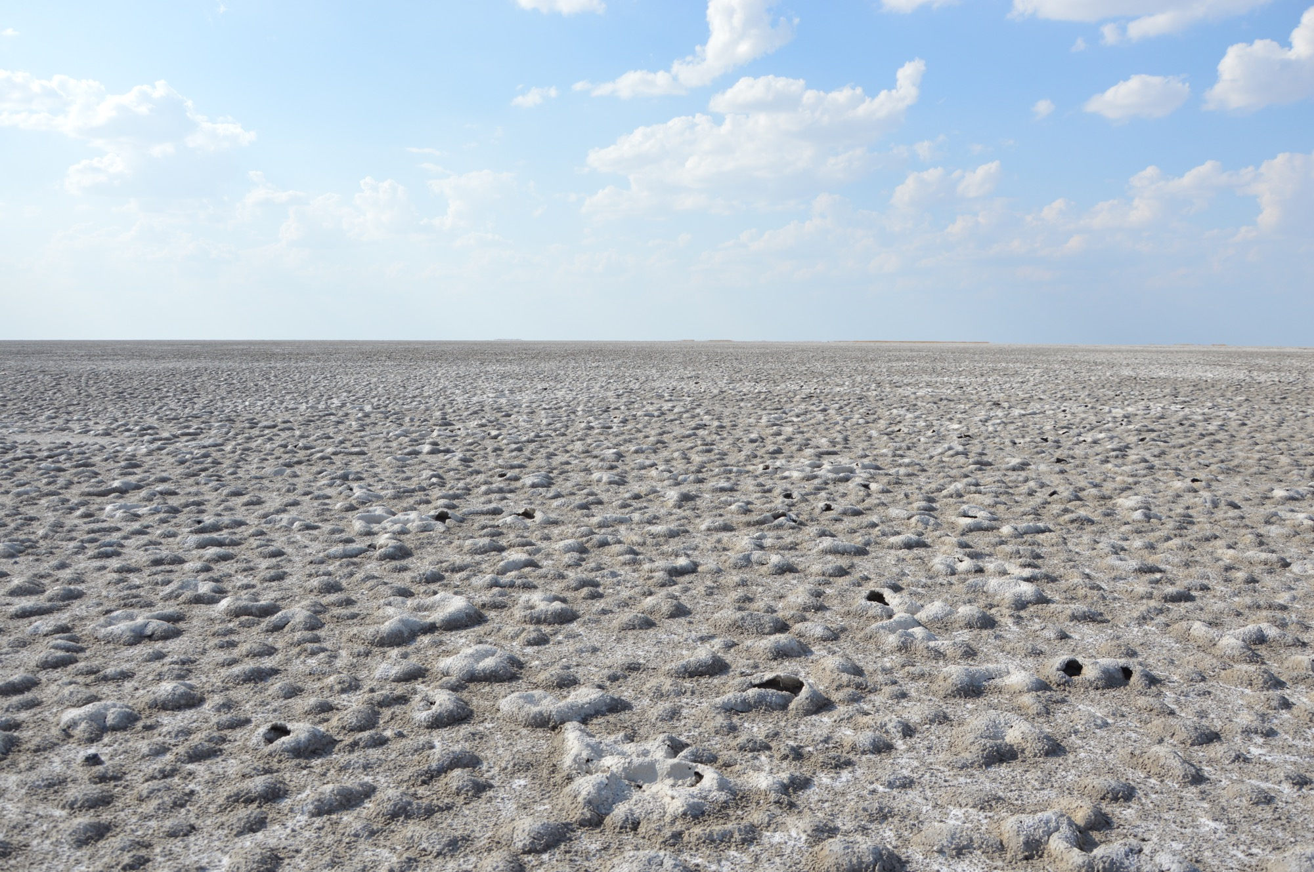
Lecture 5 – Terrestrial Analogues for planetary exploration
TOPICS TO BE COVERED:
Definition of terrestrial analogues
Example of analogues from the African continent
Kess Kess Mounds
Makgadikgadi Pans
Analogues of icy moons

Slide 3
Definition of terrestrial analogue:
Some places on Earth are so extreme that scientists use them as stand-ins to study harsh environments on other worlds. These locations are called planetary analogs because they are similar, or analogous, to Earth's Moon, Mars, asteroids – and even exoplanets – planets that orbit other stars. [NASA.GOV]
EXTREME ENVIRONMENT
LIFE
LIMITS OF LIFE AS WE KNOW IT
ASTROBIOLOGY
EXTREME ENVIRONMENTS
…BUT THERE IS MUCH MORE!

Slide 4
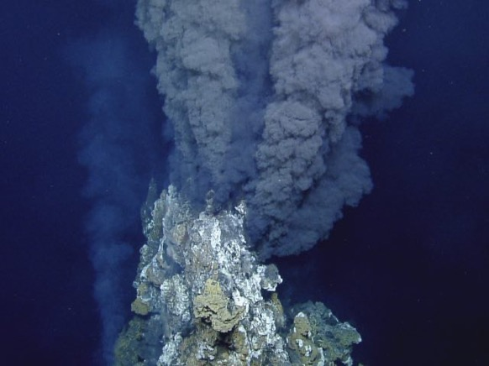
WARNING!
Ingredients for extra-terrestrial life:
ORGANICS
NUTRIENTS
ENERGY
LIQUID WATER
CONVECTION

Slide 5
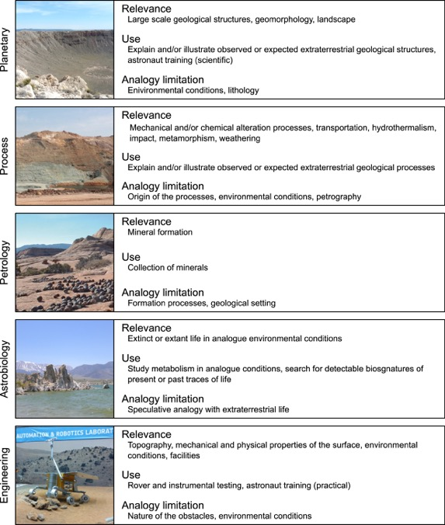
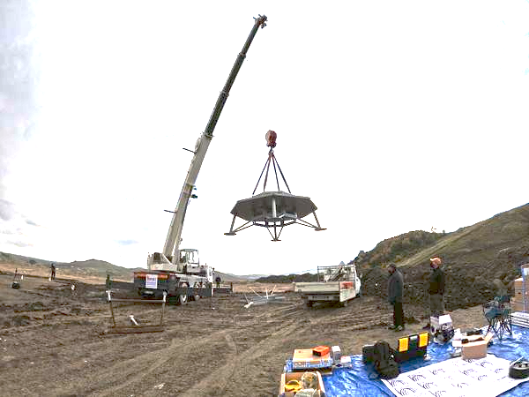
ExoMars lander
Credits: Prof. G.G. Ori - IRSPS – Ibn Battuta Centre
Credits: Foucher et al., 2021 – PSS 197, 105162

Slide 7
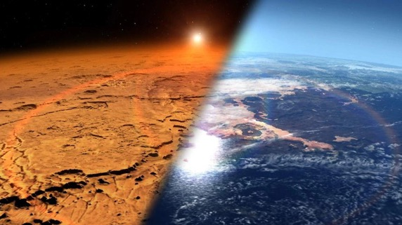
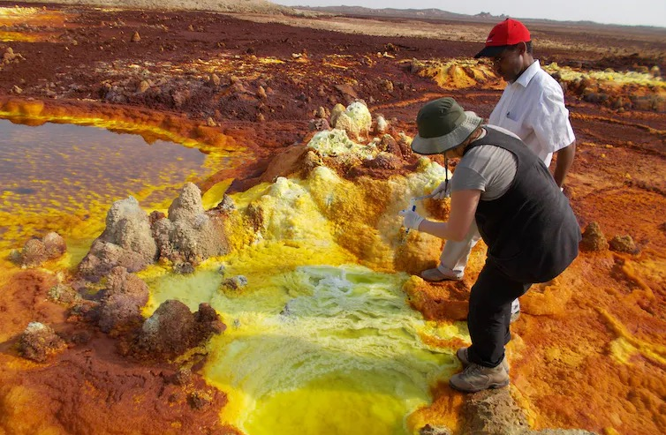
What are we looking for in these ‘extreme environments’?
Strong evaporation
UV radiation
T, pH, alkalinity
Credits: ESA

Slide 8
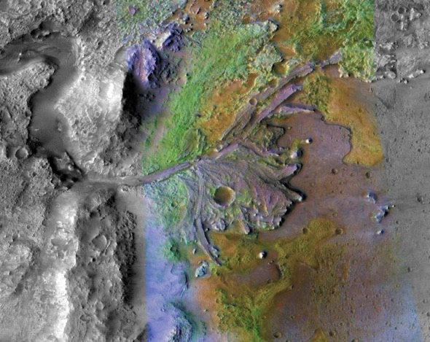
Similarities that strike the imagination of scientists…
Franchi et al., 2020 – PPS, 192
Jazero Crater, landing site Mars 2020
Makgadikgadi pans, Botswana

Slide 9
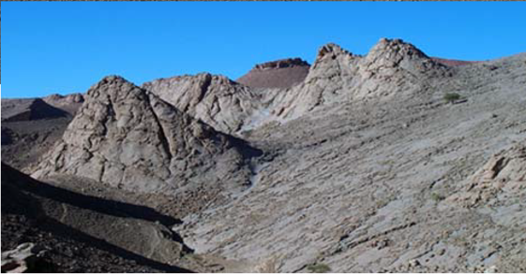
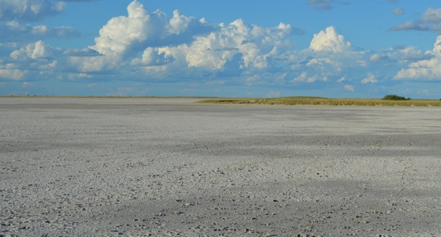
Kess Kess mounds
Makgadikgadi salt pans

Slide 10
Kess Kess mounds
Makgadikgadi salt pans

Slide 11
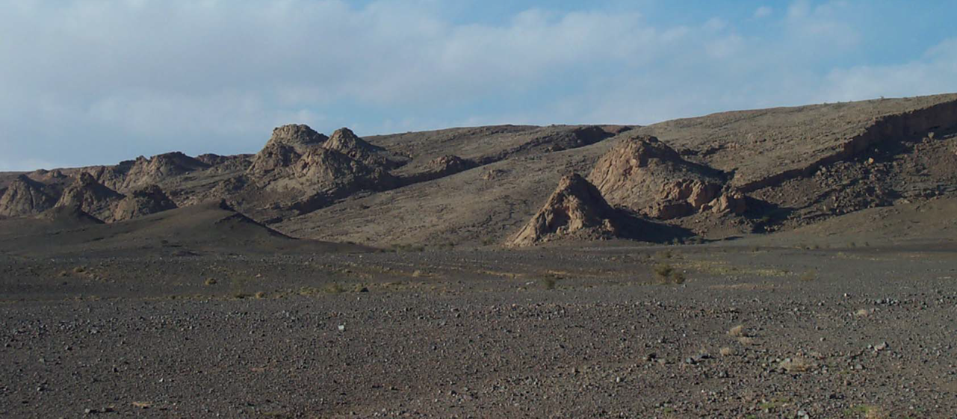
Kess Kess - Morocco

Slide 12
Kess Kess
Franchi et al., 2014 – PSS 92, 34-48
Hollard Mound
CH₄

Slide 13
The Kess Kess mounds in Morocco are good candidates for astrobiological studies because they have characteristics that can be compared to Martian ones, e.g.:
They are conical mounds formed along faults
They are potentially linked to methane seepage
They might have had interactions with hydrothermal fluids
Carbonates with strong potential of preservation of microbial signatures

Slide 14
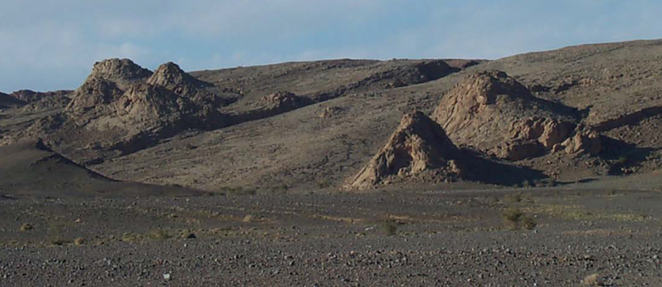
Credits: Franchi et al., 2014 – PSS 92, 34-48
Why the Kess Kess are so interesting?
1) Sedimentary units and ’mounds’ on Mars!!
H₂O

Slide 15
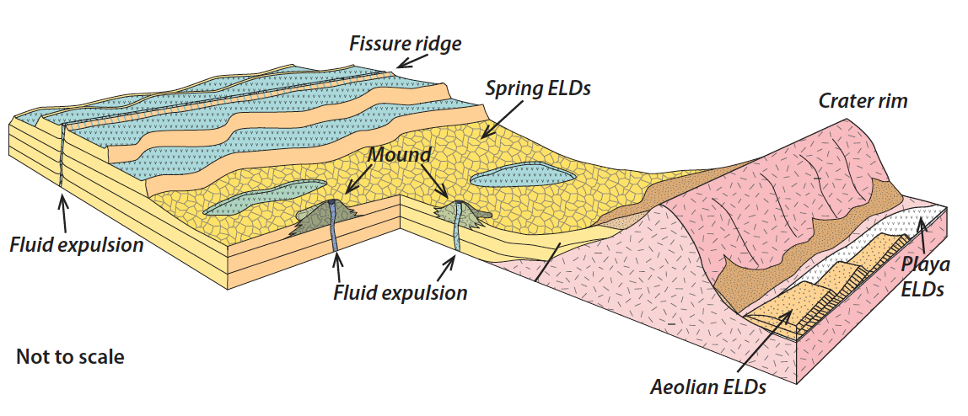
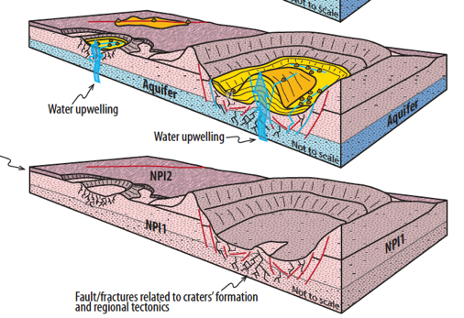
Why the Kess Kess are so interesting?
2) Linked to fluids upwelling
Pondrelli et al.,2015 - Geological Society of America Bulletin

Slide 16
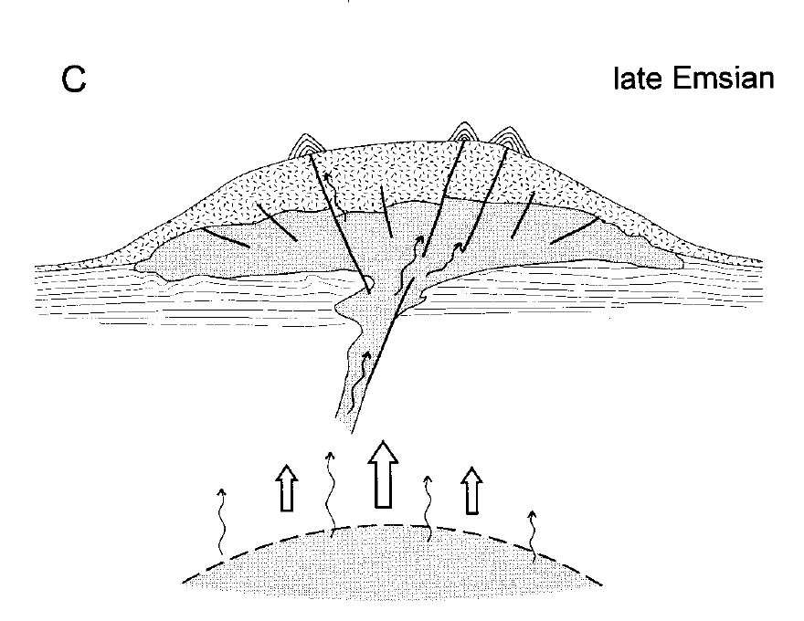
CONICAL MOUNDS FORMED ALONG FAULTS
Belka, 1998
Fluids seepage at the seafloor during the Devonian induced the formation of carbonates.

Slide 17
INTERACTIONS WITH HYDROTHERMAL FLUIDS
Hydrothermal vents that can sustain chemo-autotrophic communities: link to early life and also with Mars and other celestial bodies.
Franchi et al., 2016 – Sed. Geology 343, 56-71

Slide 18
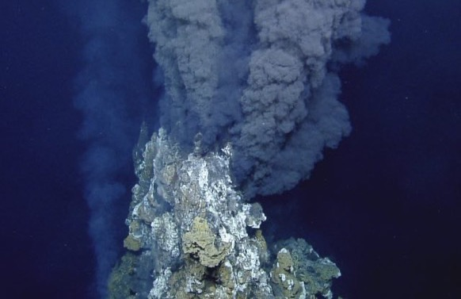
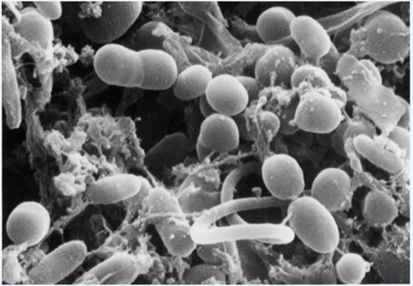
INTERACTIONS WITH HYDROTHERMAL FLUIDS
Similar to present day black and/or white smokers?
Credits: Carl Wirsen, WHOI

Slide 19
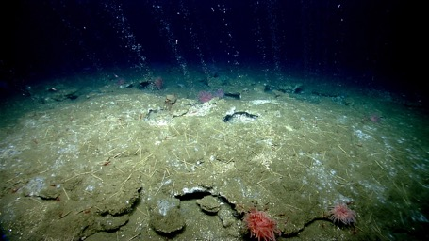
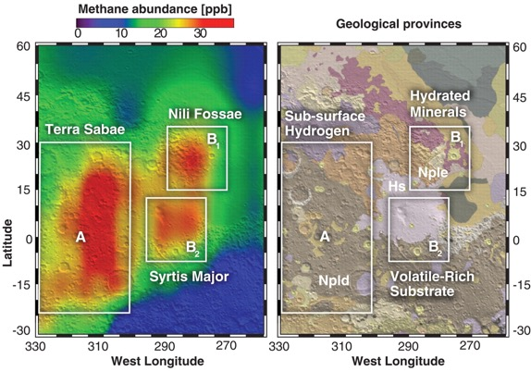
Why the Kess Kess are so interesting?
3) Methane on Mars!!
Mumma et al., 2009 - Strong Release of Methane on Mars in Northern Summer 2003 – Science 323
Cold seeps
CH₄

Slide 20
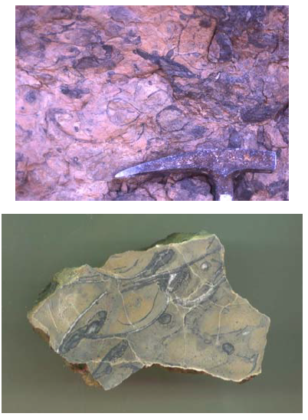
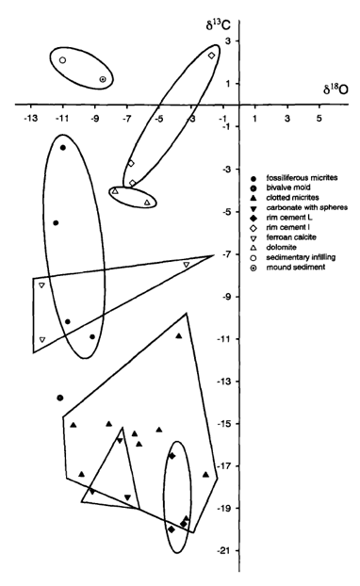
LINKED TO METHANE SEEPAGE
Chemosymbiotic organisms and methanotrophic communities.
Peckmann et al., 1999 – Facies 40, 281-296
Cavalazzi et al., 2007 – Sed. Geology 200, 73-80

Slide 21
LINKED TO METHANE SEEPAGE
Credits: NOAA Office of Ocean Exploration and Research, 2013 ROV Shakedown and Field Trials in the U.S. Atlantic Canyons.

Slide 22
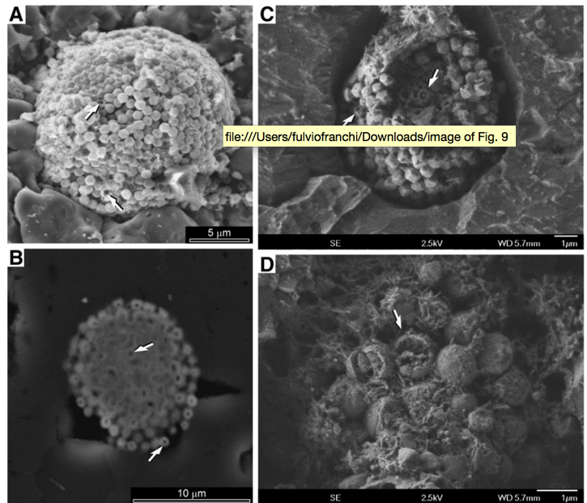
HIGH POTENTIAL FOR PRESERVATION OF MICROBIAL SIGNATURES
Cavalazzi et al. 2007 – Sed. Geology 200, 73–88
Cavalazzi et al. 2011 – Sed. Geology

Slide 23
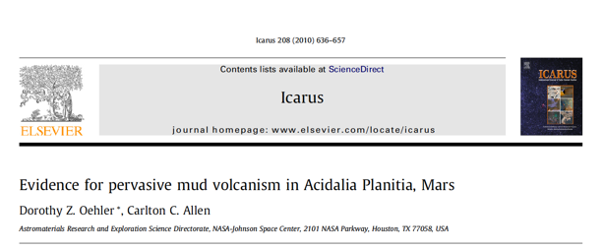
Why the Kess Kess are so interesting?
Credits: Franchi et al., 2014 – PSS 92, 34-48
4) Processes active on Mars!!

Slide 24
Kess Kess mounds
Makgadikgadi salt pans

Slide 25
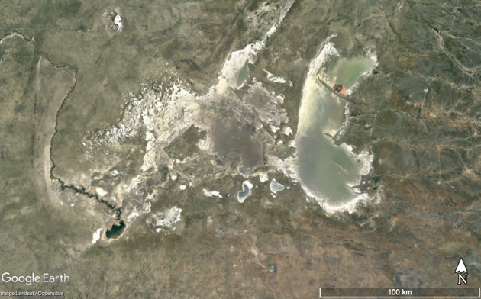
The Makgadikgadi Pans in Botswana are good candidates for astrobiological studies because they have characteristics that can be compared to Martian ones, e.g :
UV radiations – Mars surface is bombarded by radiations
Hypersaline environment - playa deposits on Mars
Morphologies similar to ELDs
Groundwater upwelling + evaporation
Morphologies due to aeolian erosion
Fossil drainage systems

Slide 26
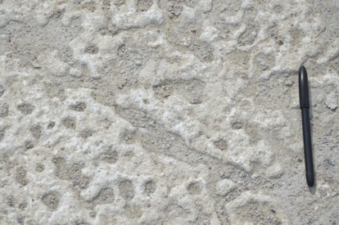
Strong UV radiation

Slide 27
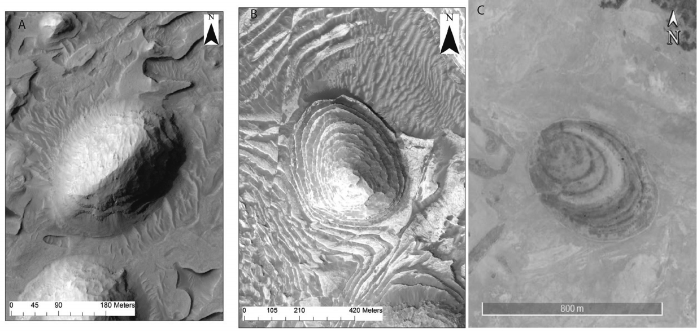
Mars or Earth?

Slide 28
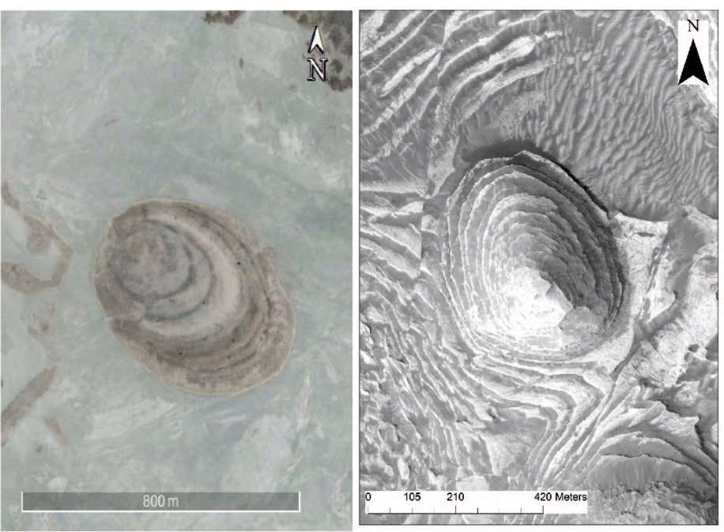
MORPHOLOGIES SIMILAR TO ELDs
What is the process that forms these morphologies in the pans?
Why the terrestrial mounds look like those on Mars?
What role plays the groundwater?

Slide 29
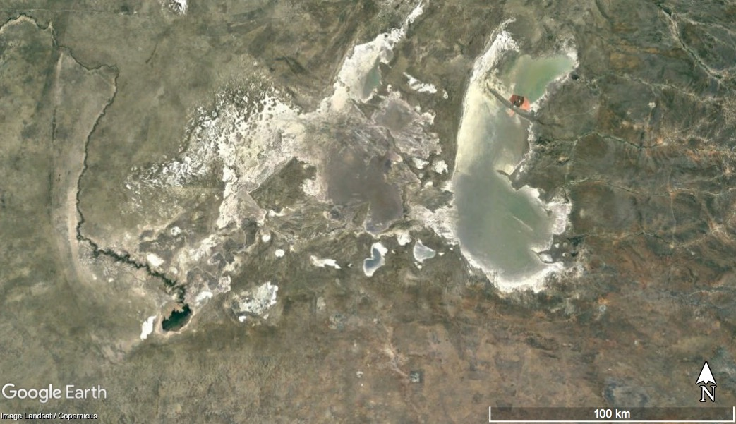

Slide 30
EVAPORAZIONE E RISALITA DI FLUIDI (ACQUA DI FALDA)
Electrical resistivity Tomography
Geophysical profiles showed the rising of the groundwater table (capillary fringe) under the mound buildups.

Slide 31
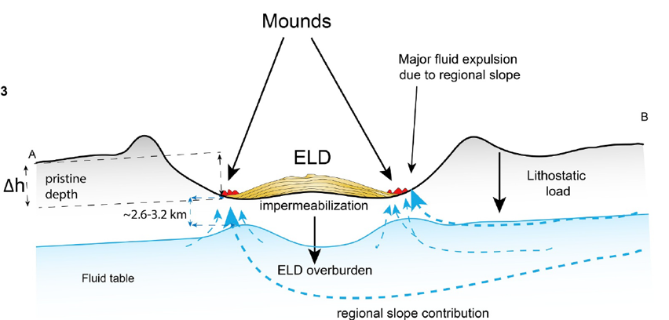
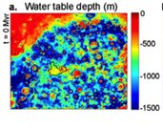
Pressurized aquifers in the equatorial region of Mars
LAYERED DEPOSITS & MOUNDS
Andrews-Hanna et al., 2007
Andrews-Hanna et al., 2010
Pozzobon et al., 2019

Slide 32
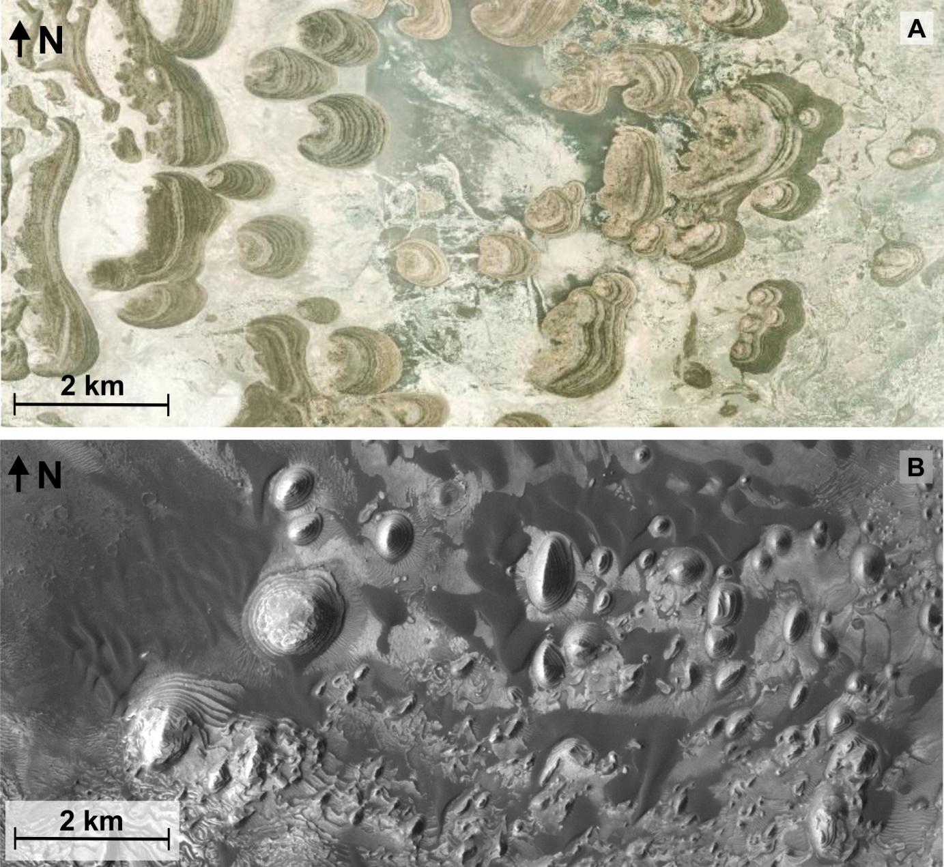
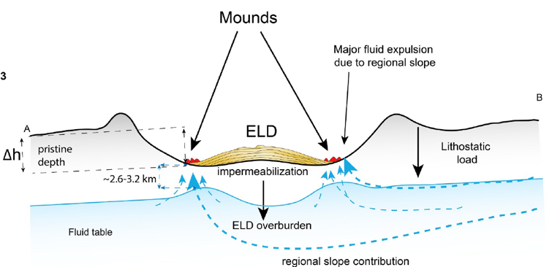
McFarlane and Long, 2015
Pozzobon et al., 2019
Schmidt et al., 2023 – Frontiers in Astronomy and space Science

Slide 33
MORPHOLOGIES LINKED TO WIND EROSION + GROUNDWATER
The mounds identified in the Makgadikgadi pans are formed by the interplay of surface runoff, wind erosion and groundwater upwelling.
Layered deposits along the paleoshoreline
Furrows formed by surface runoff

Slide 34
MORPHOLOGIES LINKED TO WIND EROSION + GROUNDWATER
The mounds identified in the Makgadikgadi pans are formed by the interplay of surface runoff, wind erosion and groundwater upwelling.
C) Surface runoff and wind erosion continue
D) Mound isolated on the pan surface

Slide 35
MORPHOLOGIES LINKED TO WIND EROSION + GROUNDWATER
The mounds identified in the Makgadikgadi pans are formed by the interplay of surface runoff, wind erosion and groundwater upwelling.
Shallow groundwater table below the pan surface
The mound acts as a ‘sponge’ and the water table rises under the buildup

Slide 36
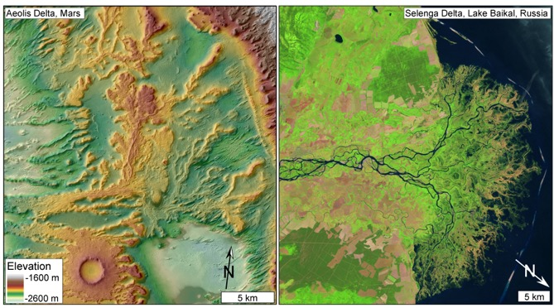
FOSSIL DRAINAGE SYSTEMS ON MARS
Mars rock record shows clear evidences of fossil deltas, channels, and complex drainage systems.
DiBiase et al., 2013 - Journal of Geophysical Research
Jezero Crater, landing site Mars 2020

Slide 37
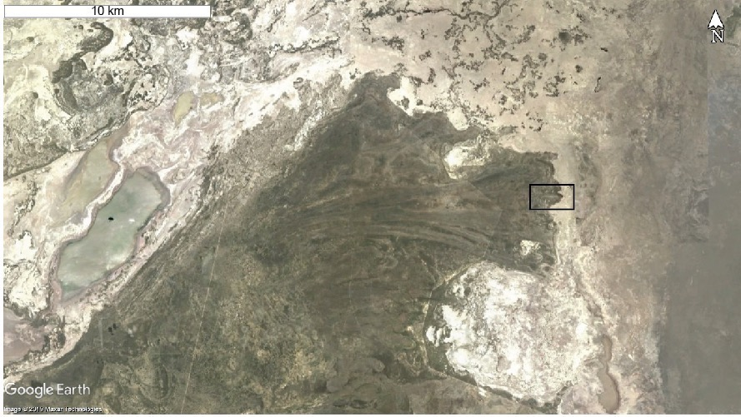

Slide 38
Franchi et al., 2020 – PPS 192

Slide 40
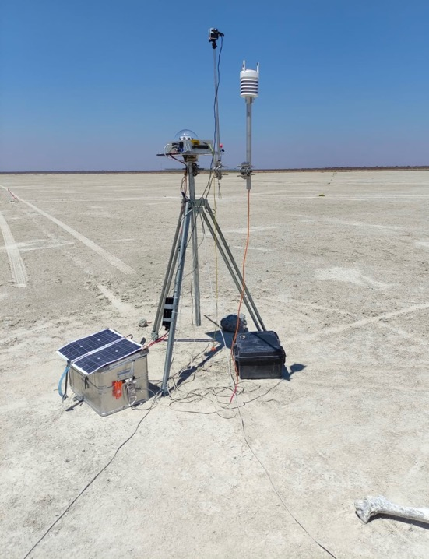
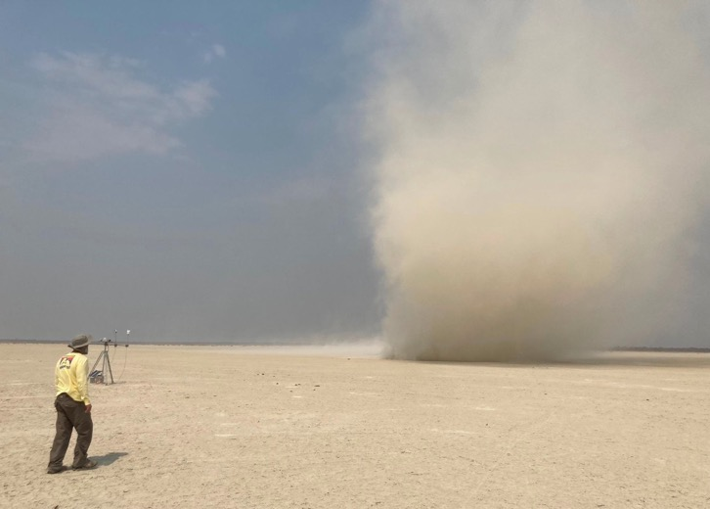

Slide 41
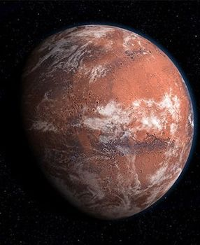
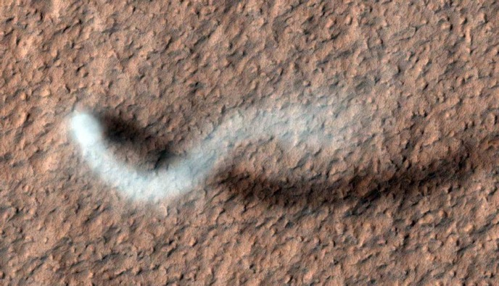
Dust devils
Curiosity Rover

Slide 42
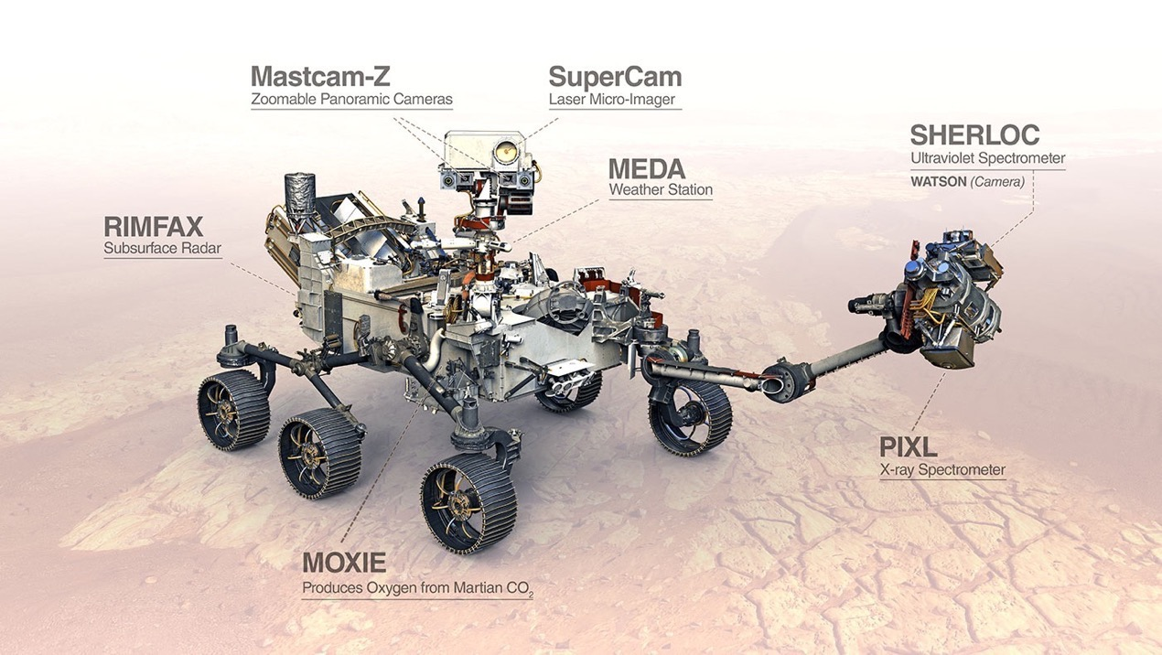
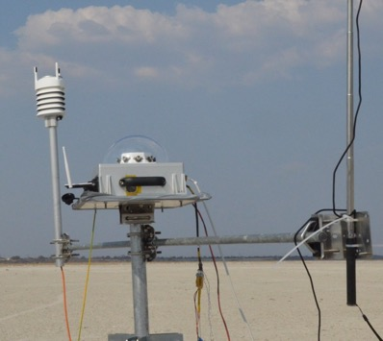
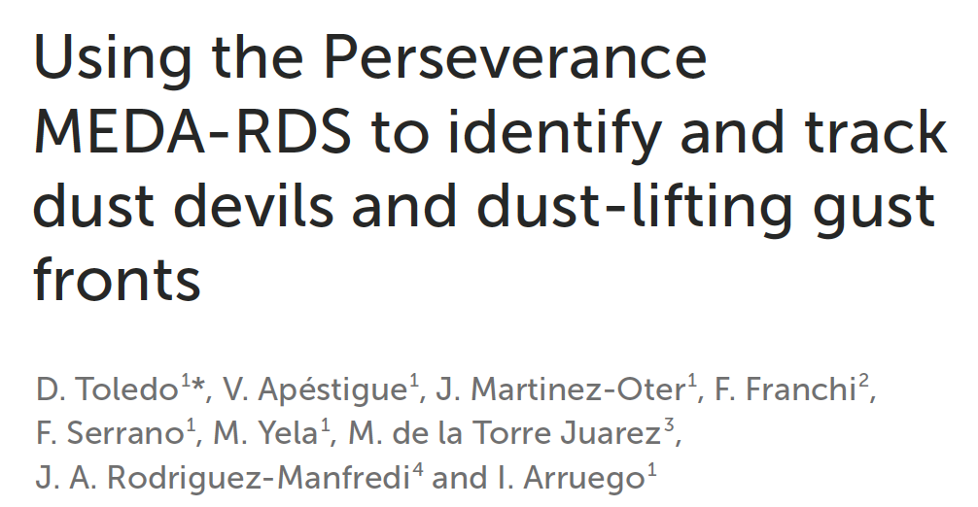
Perseverance Rover

Slide 43
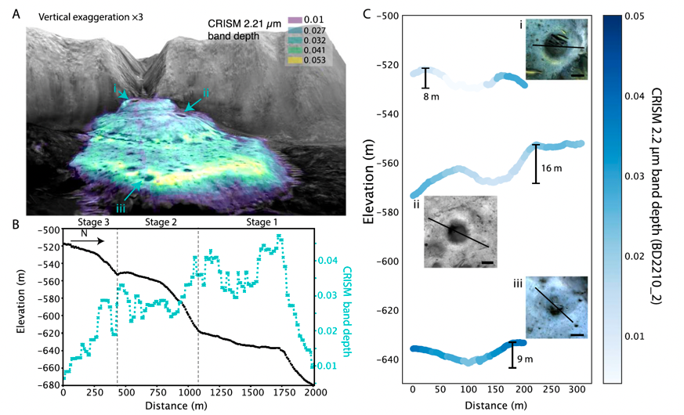
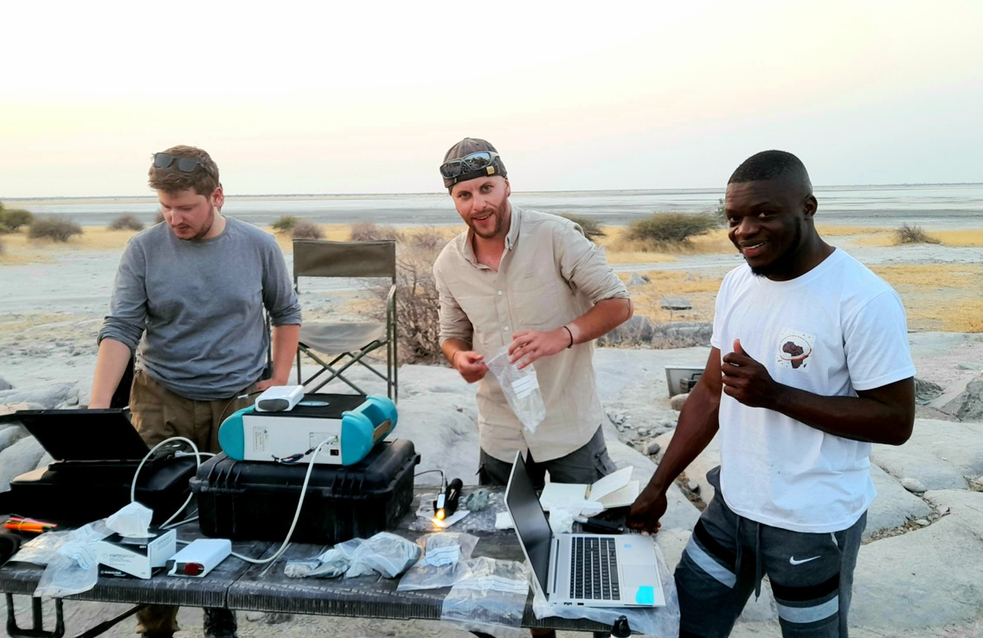
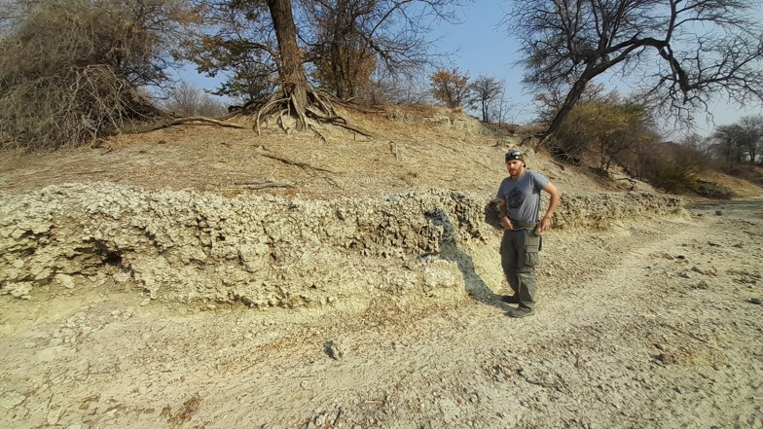
MINERALS AND EXTREMOPHILES

Slide 44
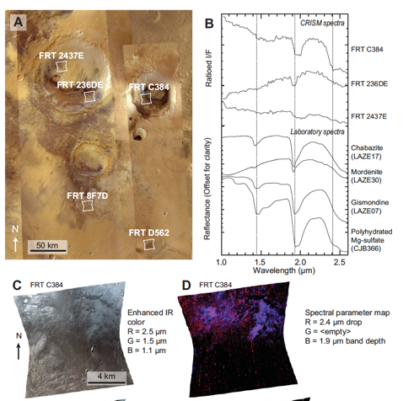
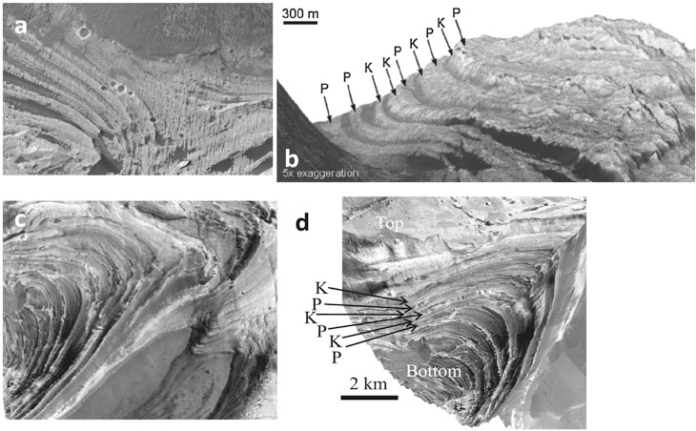
ALKALYNE ENVIRONMENT – PLAYA DEPOSITS
Evaporiti ricche in S identificate su Marte
Monohydrated Mg sulfate (MgSO₄·H₂O)
Starkeyite (MgSO₄·4H₂O)
Compact Reconnaissance Imaging Spectrometer for Mars – CRISM (MRO)
Wang et al., 2016 - JGR Planets, Volume: 121, Issue: 4, Pages: 678-694

Slide 45
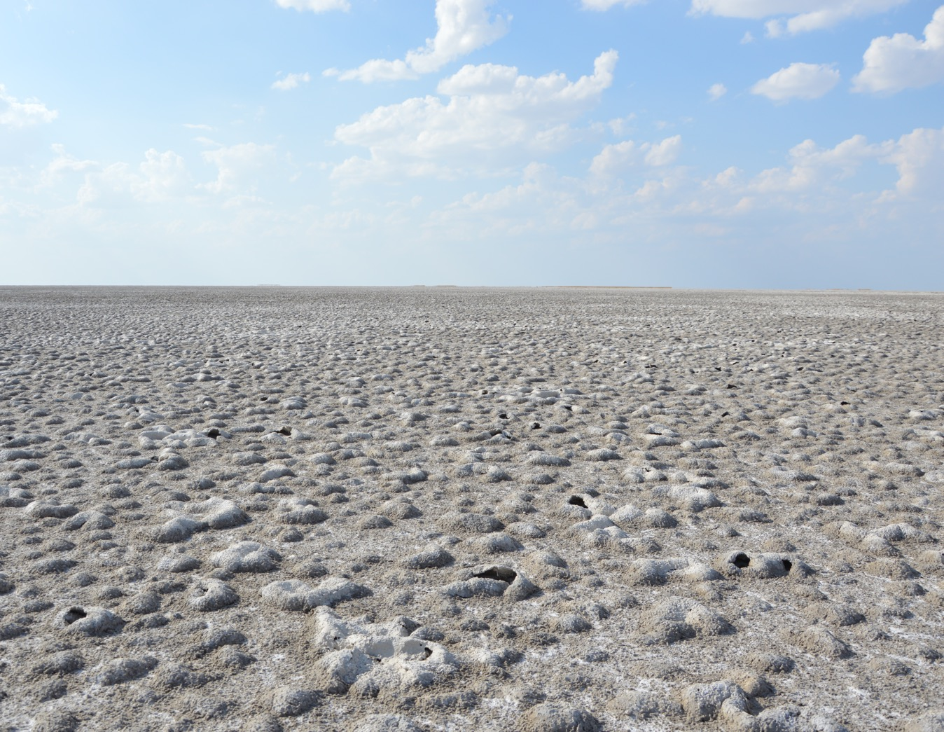
Stivaletta et al. 2009

Slide 46
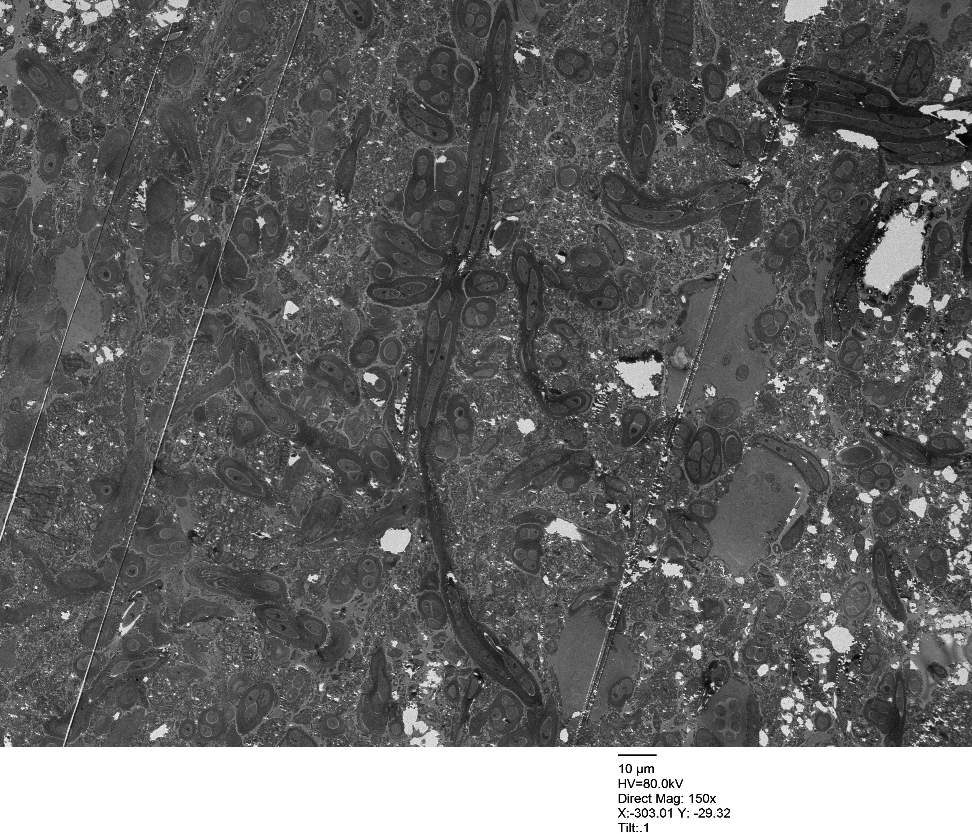

Slide 47
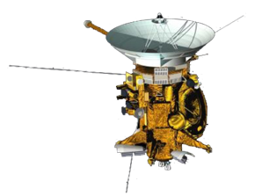
ENCELADUS
SATURN
CASSINI-HUYGENS
Notes:
During NASA’s Cassini spacecraft’s deepest-ever dive through Enceladus’ plume of gas and ice grains, researchers discovered molecular hydrogen in the material spewing from the icy moon. This discovery provides further evidence for hydrothermal activity in the ocean beneath Enceladus’ surface and heightens the possibility that the ocean could have conditions suitable for microbial life.

Slide 48
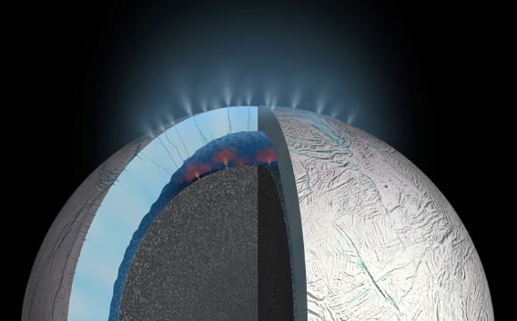
credit: NASA / JPL-Caltech / Southwest Research Institute

Slide 49
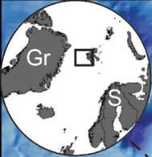
(semi)permanent ice cover
Cold seeps

Slide 52
Credits: Davide Oddone photography

Slide 53
ATOMKI Lab., Debrecen (Hungary)
Europlanet Expert exchange

Slide 54
)))))
CH₄

Slide 55
Terrestrial analogues for planetary exploration:
Terrestrial environments (or material) sharing common characteristics with extra-terrestrial environments (or materials);
Natural laboratories for experiments on minerals, geological and biological processes that might be or might have been active on other celestial bodies;
The characterization of terrestrial analogues is extremely multidisciplinary and requires collaborative efforts;
Terrestrial analogues might provide testing ground for instruments that will be part of ongoing or future missions;
They play a fundamental role for understanding what we can expect from space missions and comprehend the data that we are receiving and will receive.

Slide 56
PLANETARY FIELD ANALOGUE SITES (PFA)
THANK YOU – KE A LEBOGA

